Slide 1
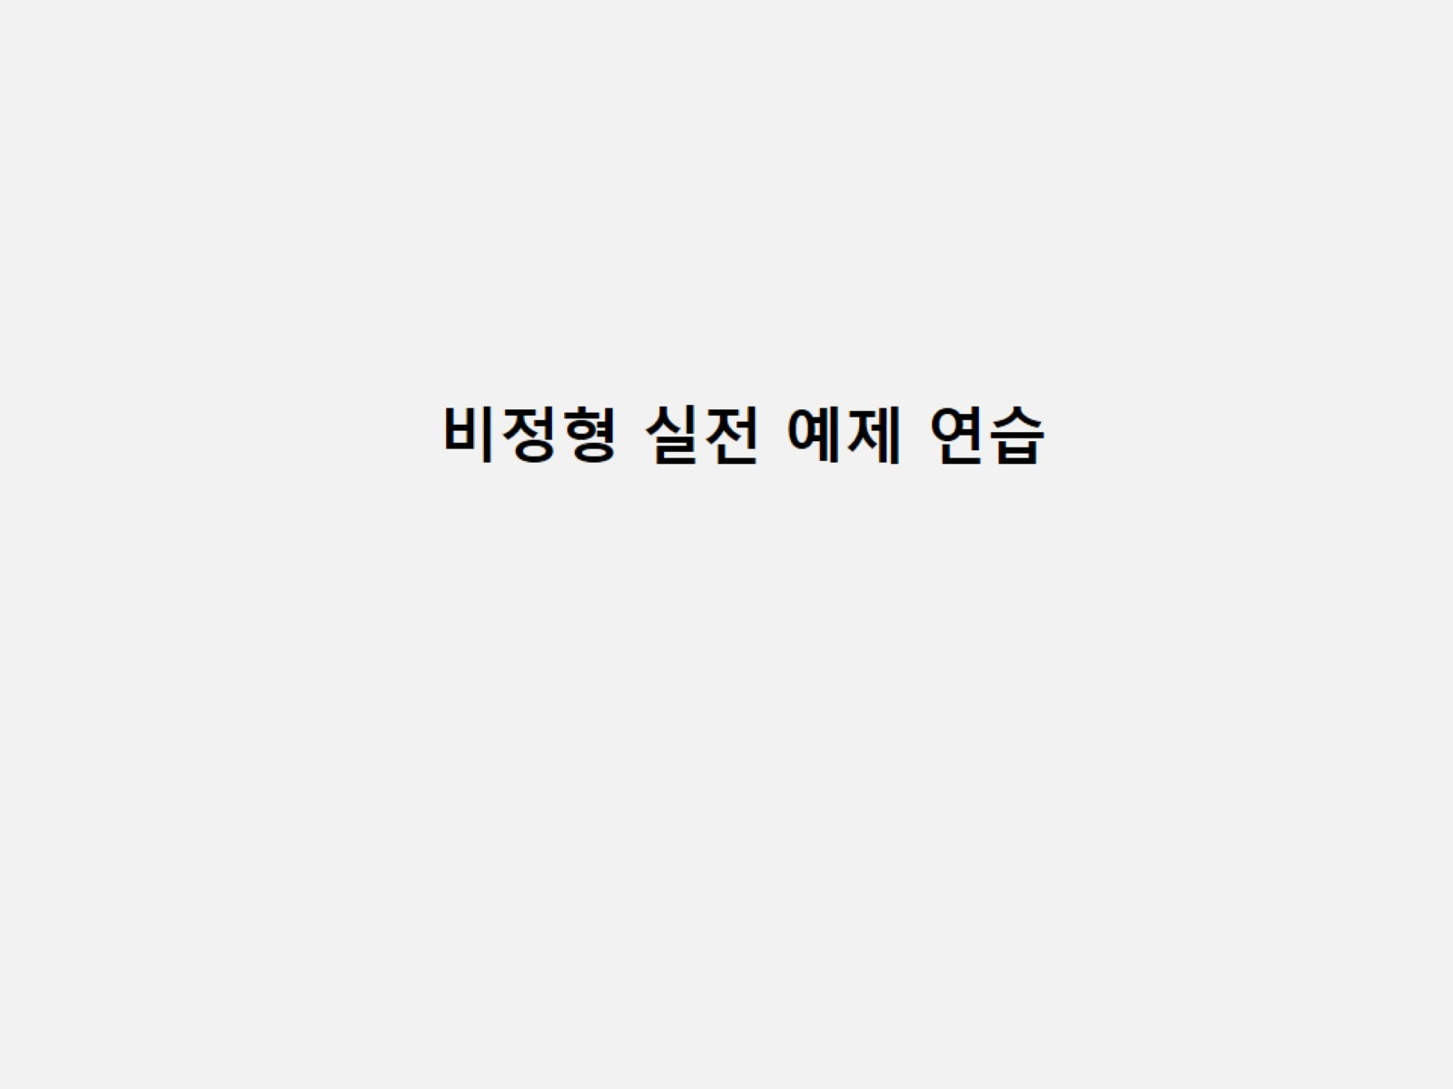

Slide 2
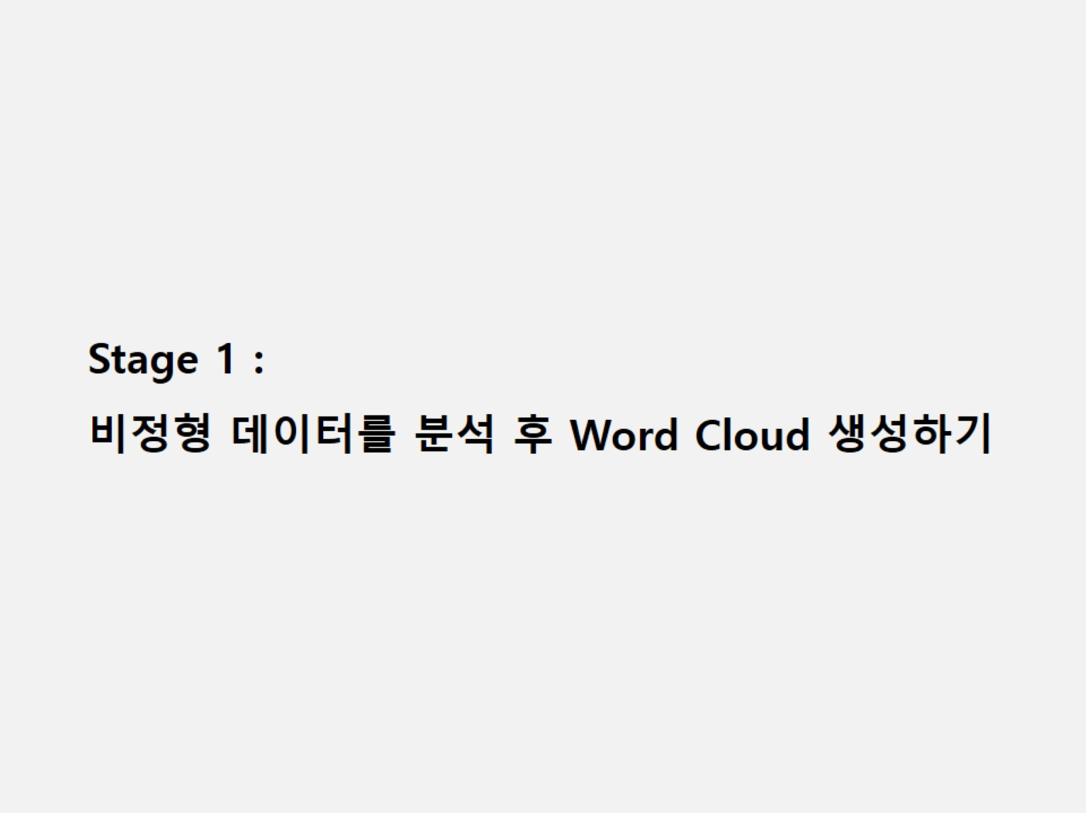

Slide 3
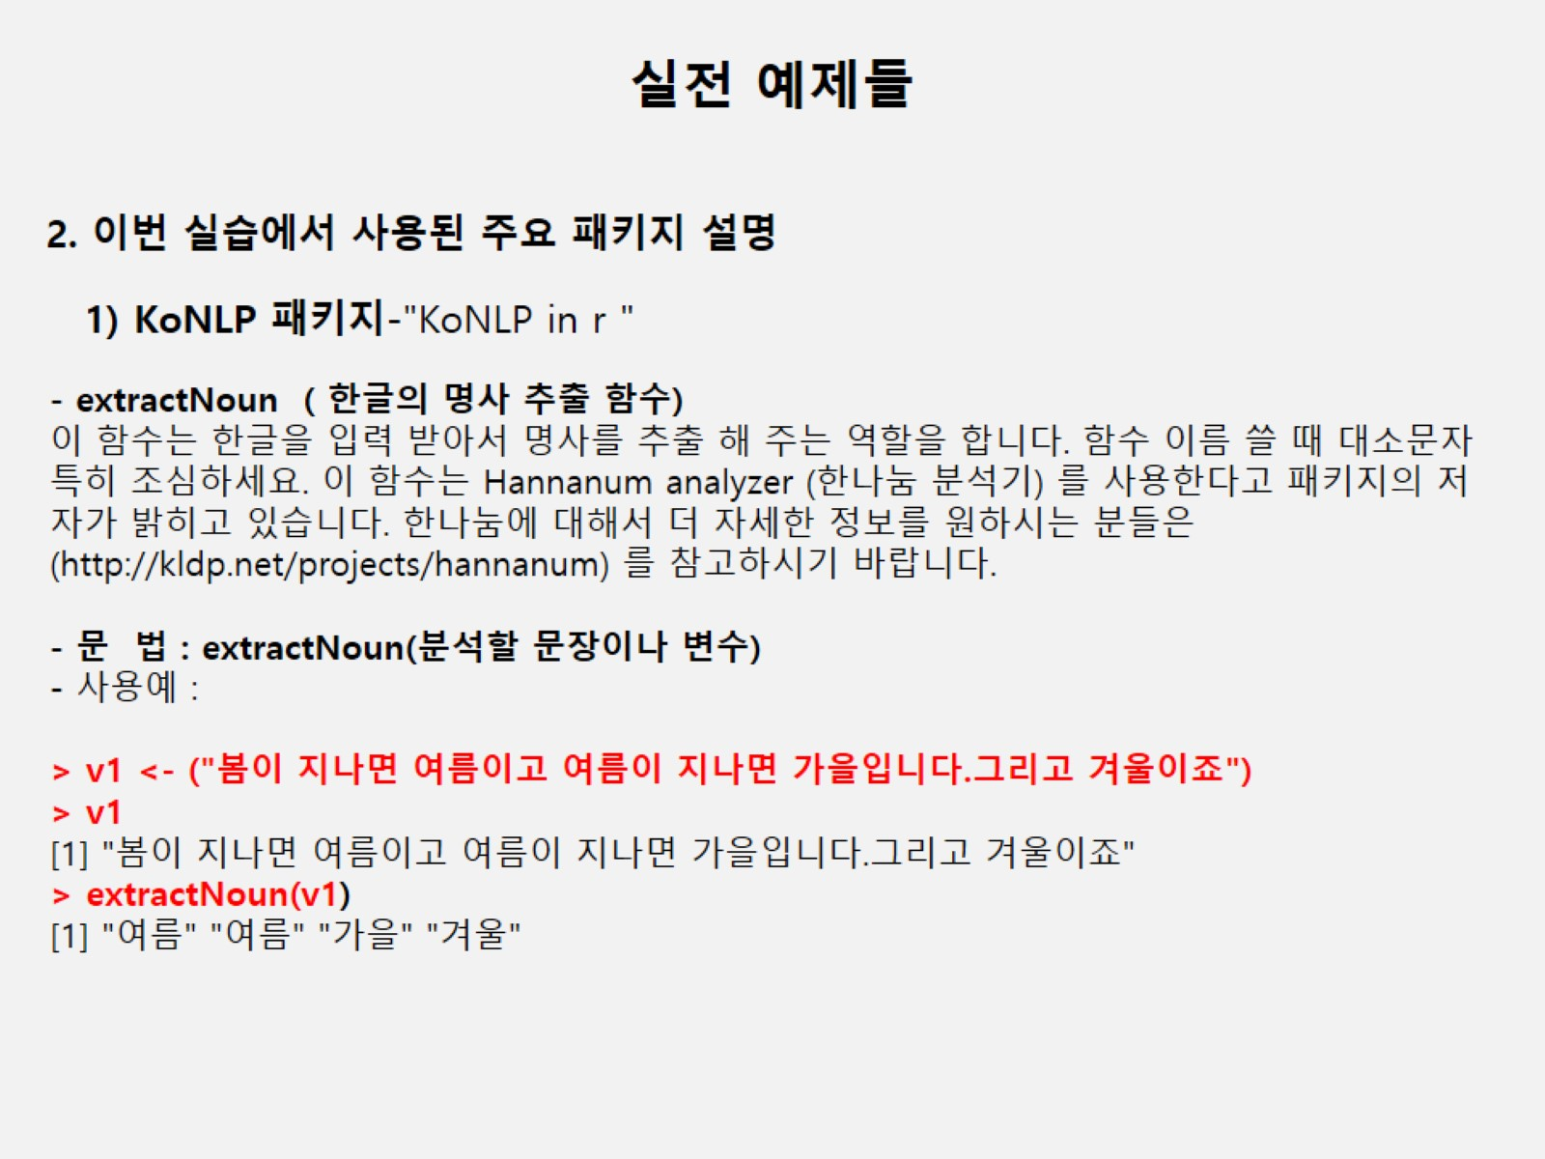

Slide 4
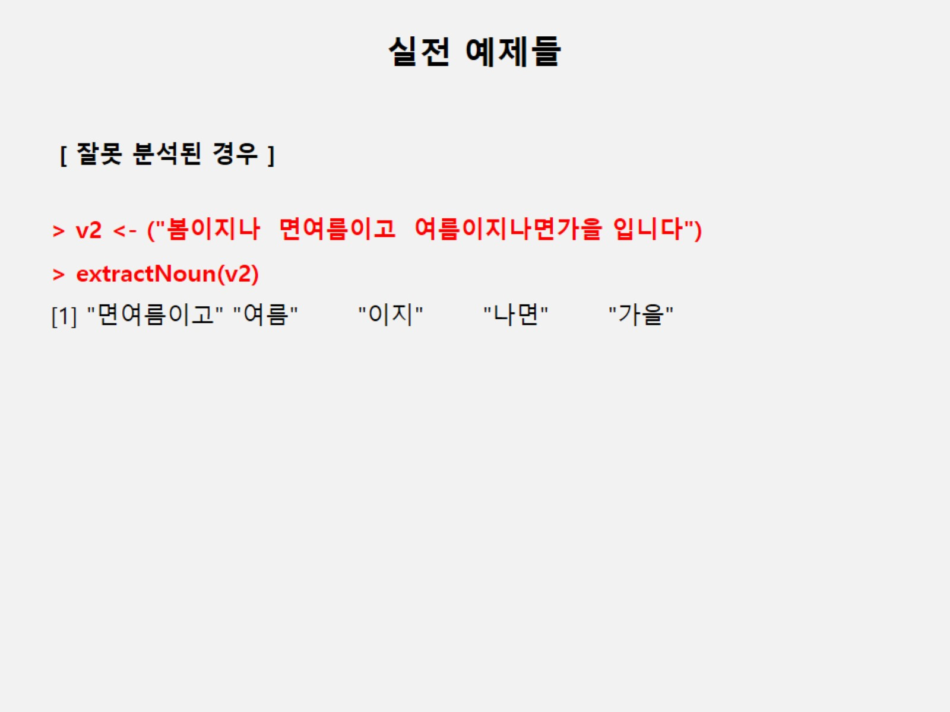

Slide 5
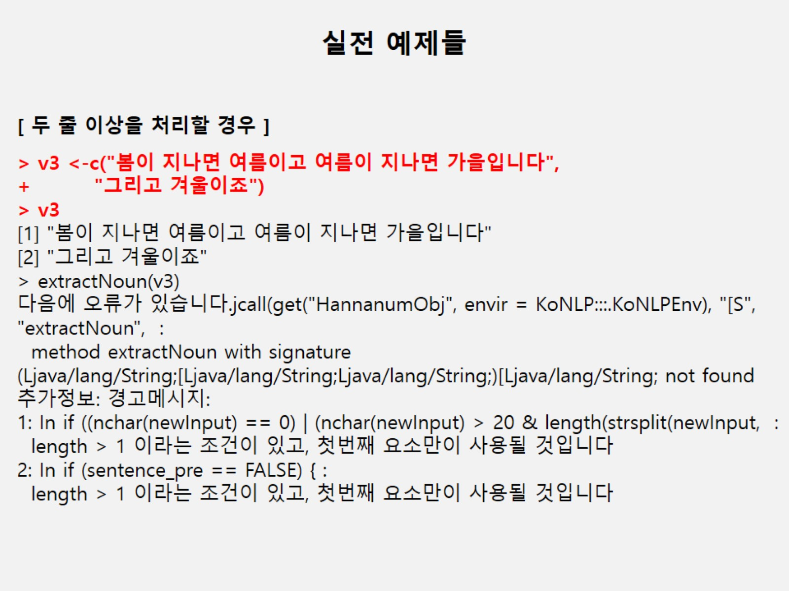

Slide 6
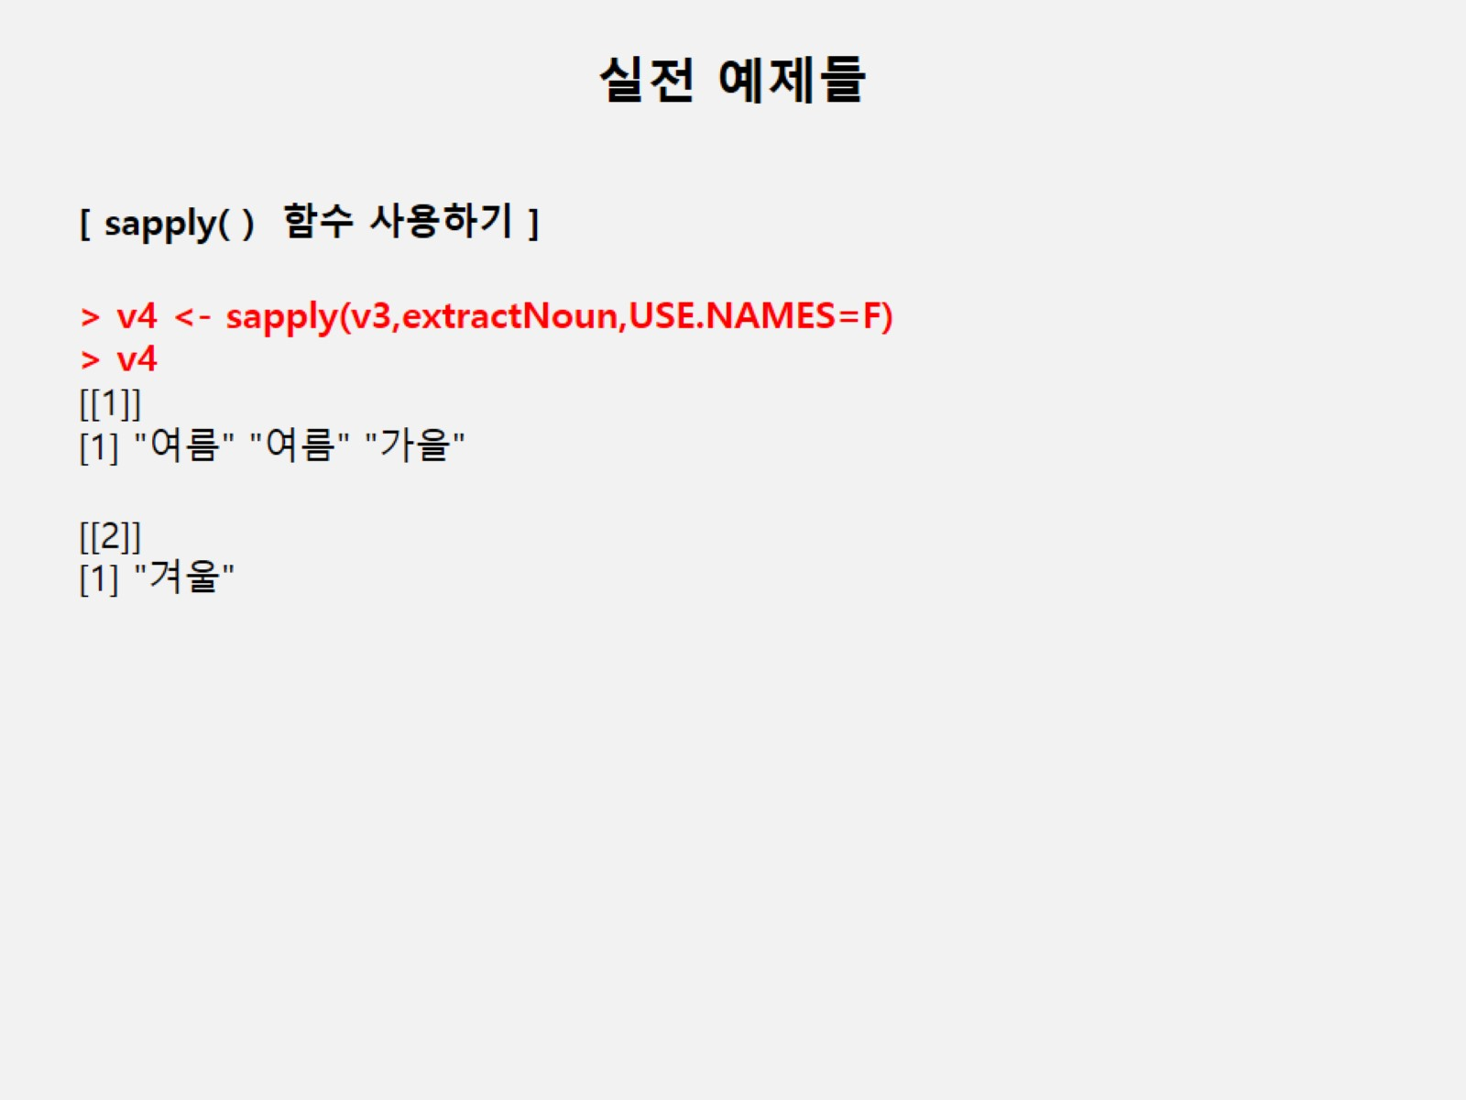

Slide 7
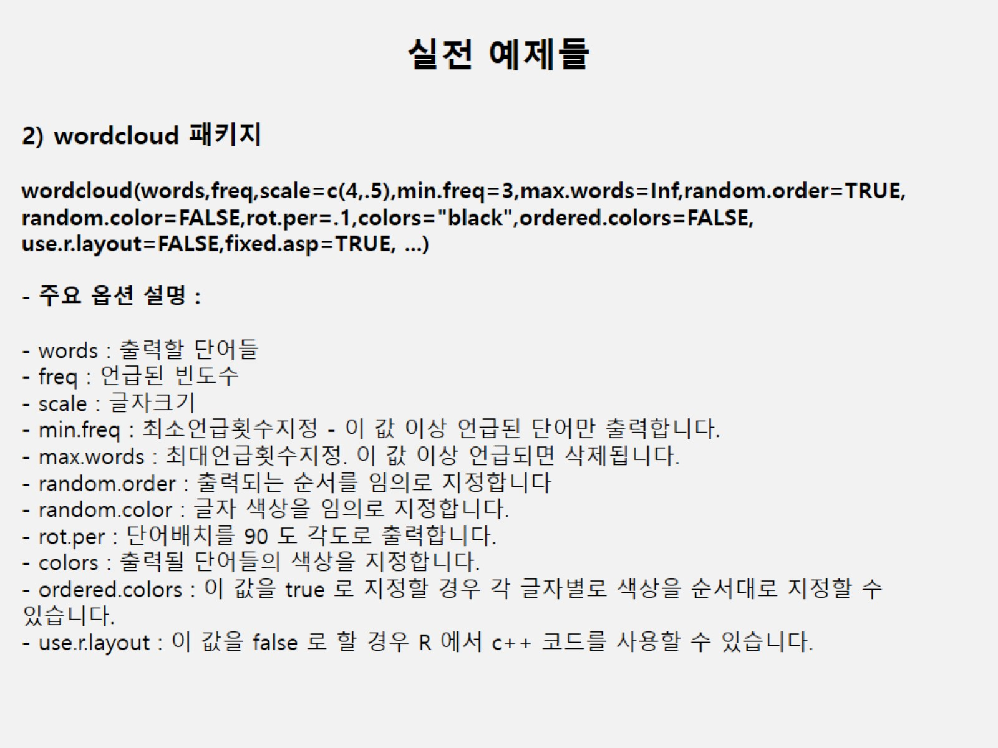

Slide 8
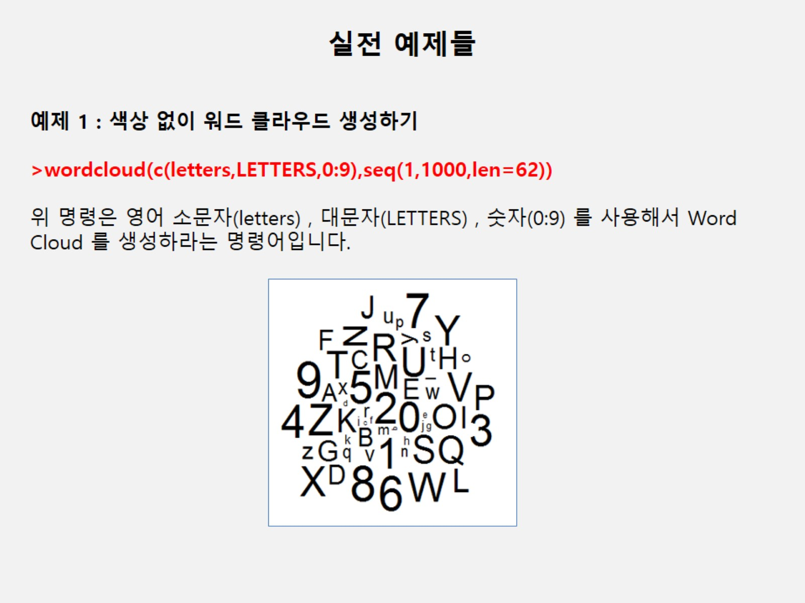

Slide 9
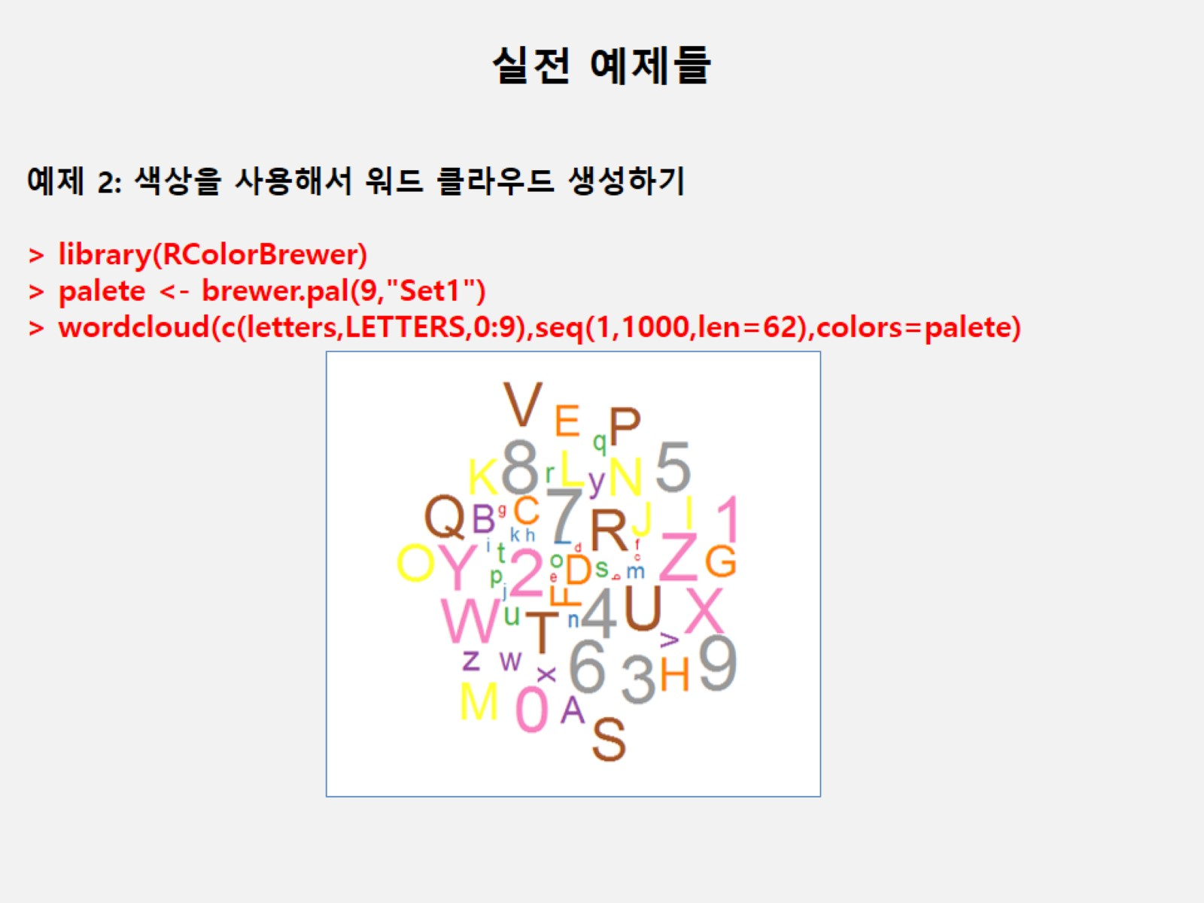

Slide 10
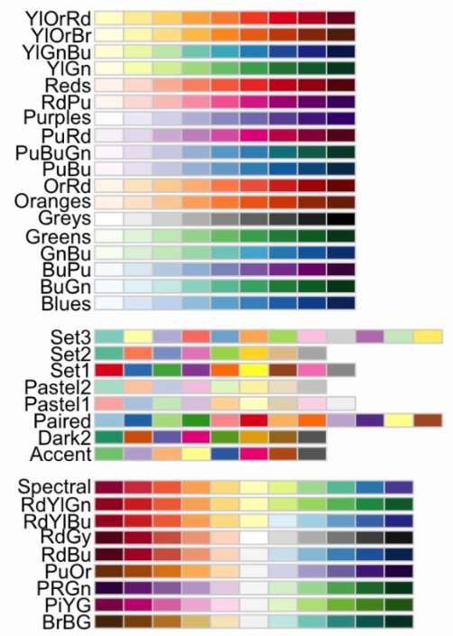

Slide 11
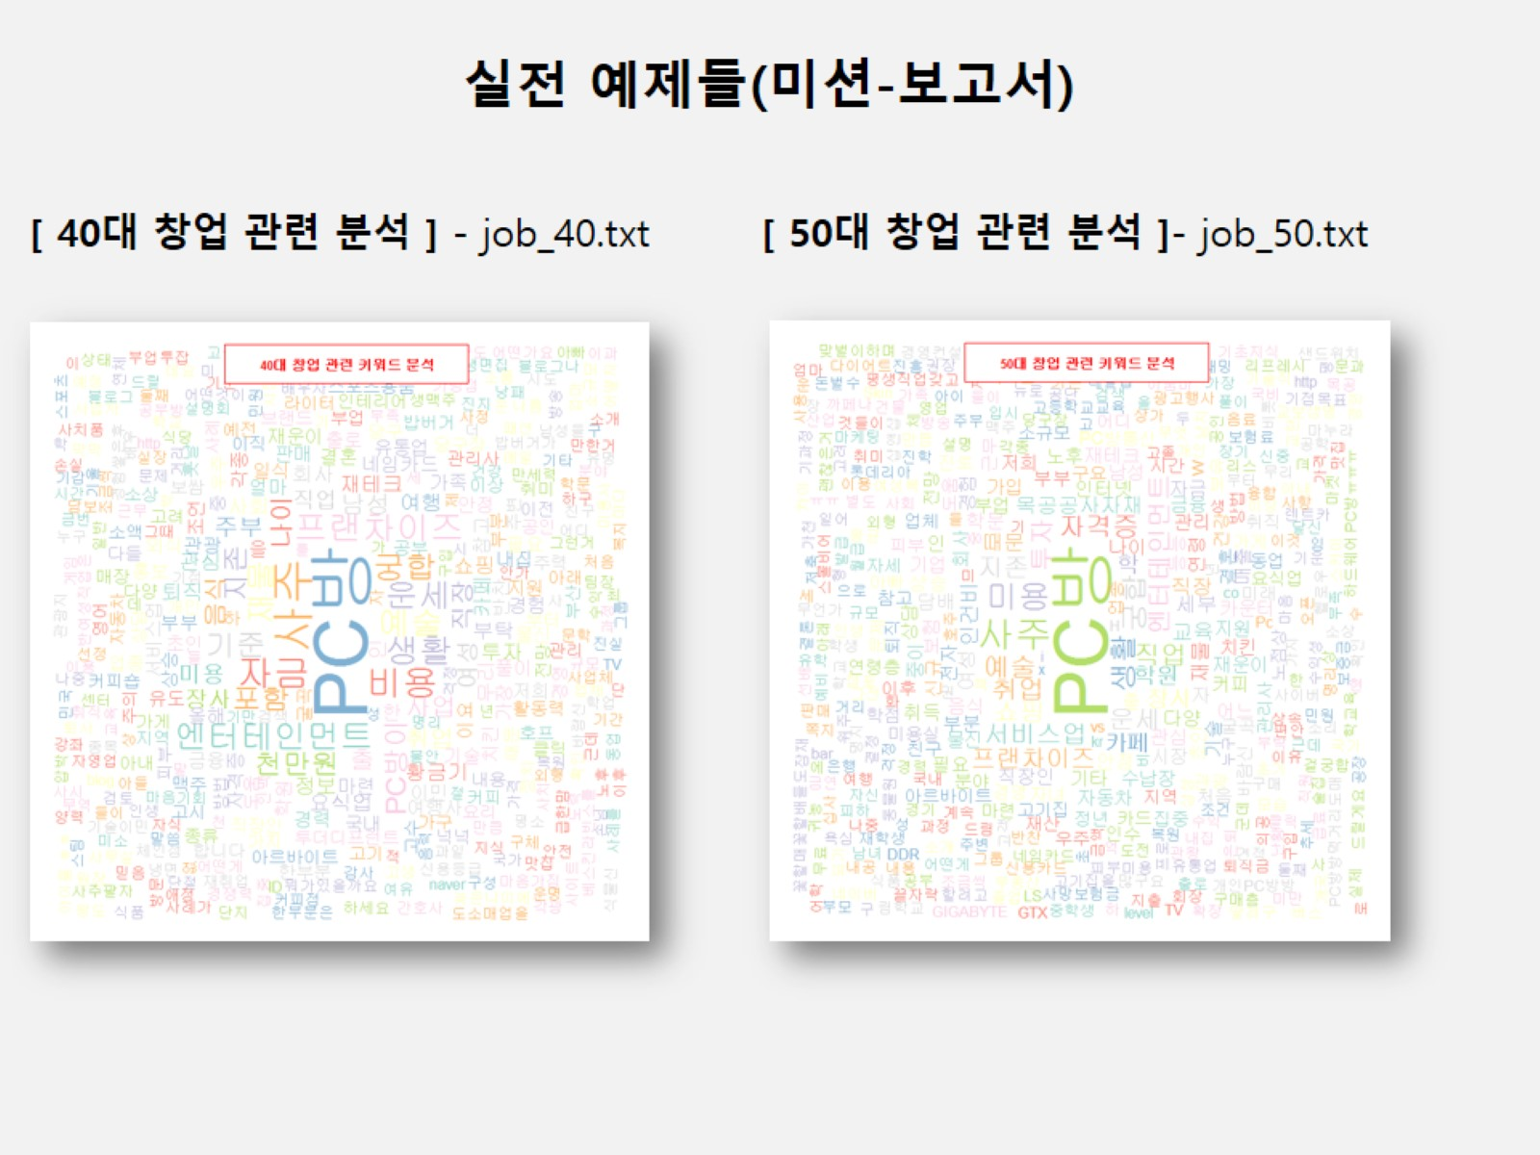

Slide 12
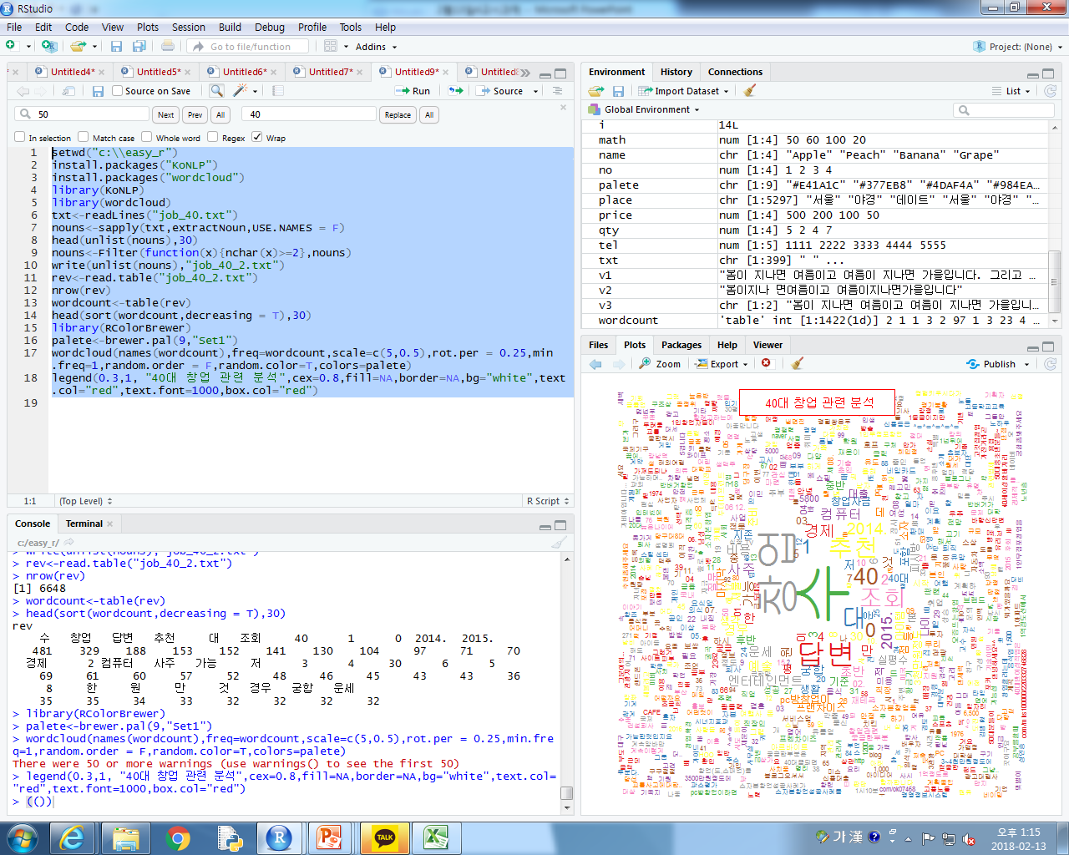
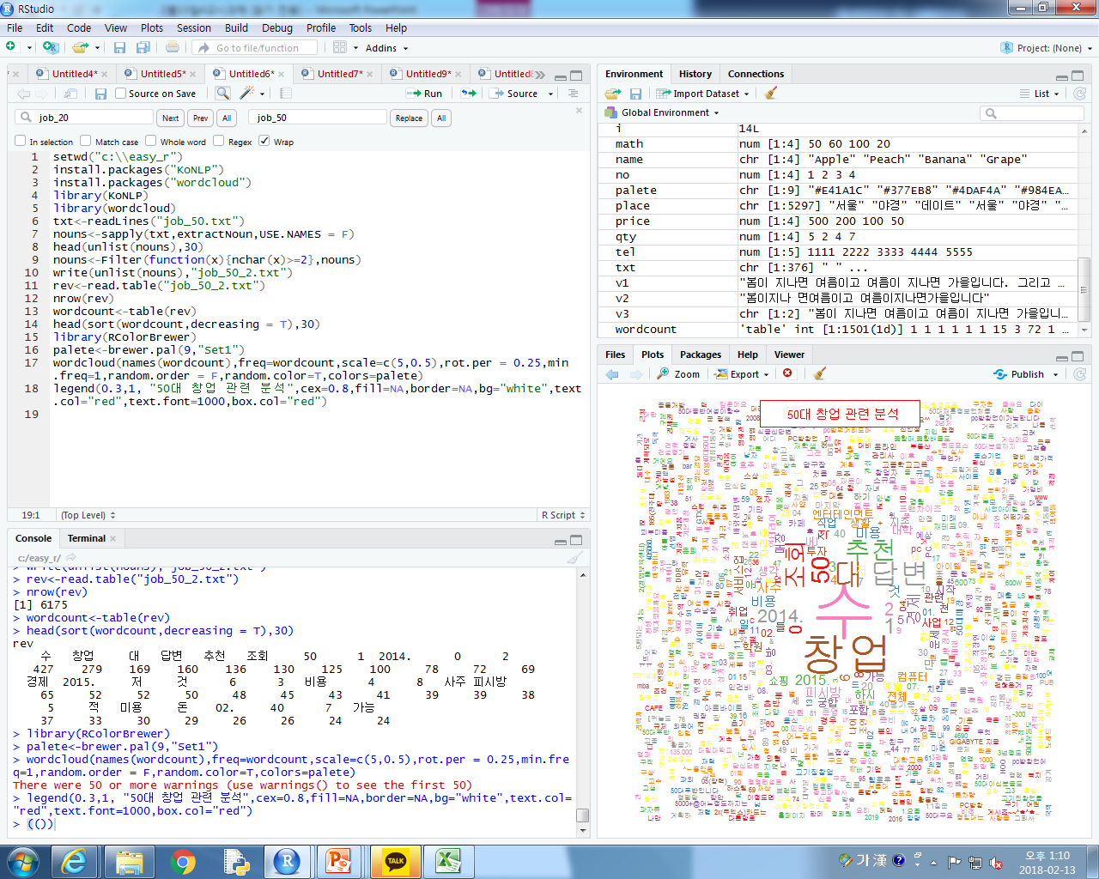
40대 VS 50대
Notes:
.setwd("c:\\easy_r")
install.packages("KoNLP")
install.packages("wordcloud")
library(KoNLP)
library(wordcloud)
txt<-readLines("job_40.txt")
nouns<-sapply(txt,extractNoun,USE.NAMES = F)
head(unlist(nouns),30)
nouns<-Filter(function(x){nchar(x)>=2},nouns)
write(unlist(nouns),"job_40_2.txt")
rev<-read.table("job_40_2.txt")
nrow(rev)
wordcount<-table(rev)
head(sort(wordcount,decreasing = T),30)
library(RColorBrewer)
palete<-brewer.pal(9,"Set1")
wordcloud(names(wordcount),freq=wordcount,scale=c(5,0.5),rot.per = 0.25,min.freq=1,random.order = F,random.color=T,colors=palete)
legend(0.3,1, "40대 창업 관련 분석",cex=0.8,fill=NA,border=NA,bg="white",text.col="red",text.font=1000,box.col="red")
setwd("c:\\easy_r")
install.packages("KoNLP")
install.packages("wordcloud")
library(KoNLP)
library(wordcloud)
txt<-readLines("job_50.txt")
nouns<-sapply(txt,extractNoun,USE.NAMES = F)
head(unlist(nouns),30)
nouns<-Filter(function(x){nchar(x)>=2},nouns)
write(unlist(nouns),"job_50_2.txt")
rev<-read.table("job_50_2.txt")
nrow(rev)
wordcount<-table(rev)
head(sort(wordcount,decreasing = T),30)
library(RColorBrewer)
palete<-brewer.pal(9,"Set1")
wordcloud(names(wordcount),freq=wordcount,scale=c(5,0.5),rot.per = 0.25,min.freq=1,random.order = F,random.color=T,colors=palete)
legend(0.3,1, "50대 창업 관련 분석",cex=0.8,fill=NA,border=NA,bg="white",text.col="red",text.font=1000,box.col="red")

Slide 13
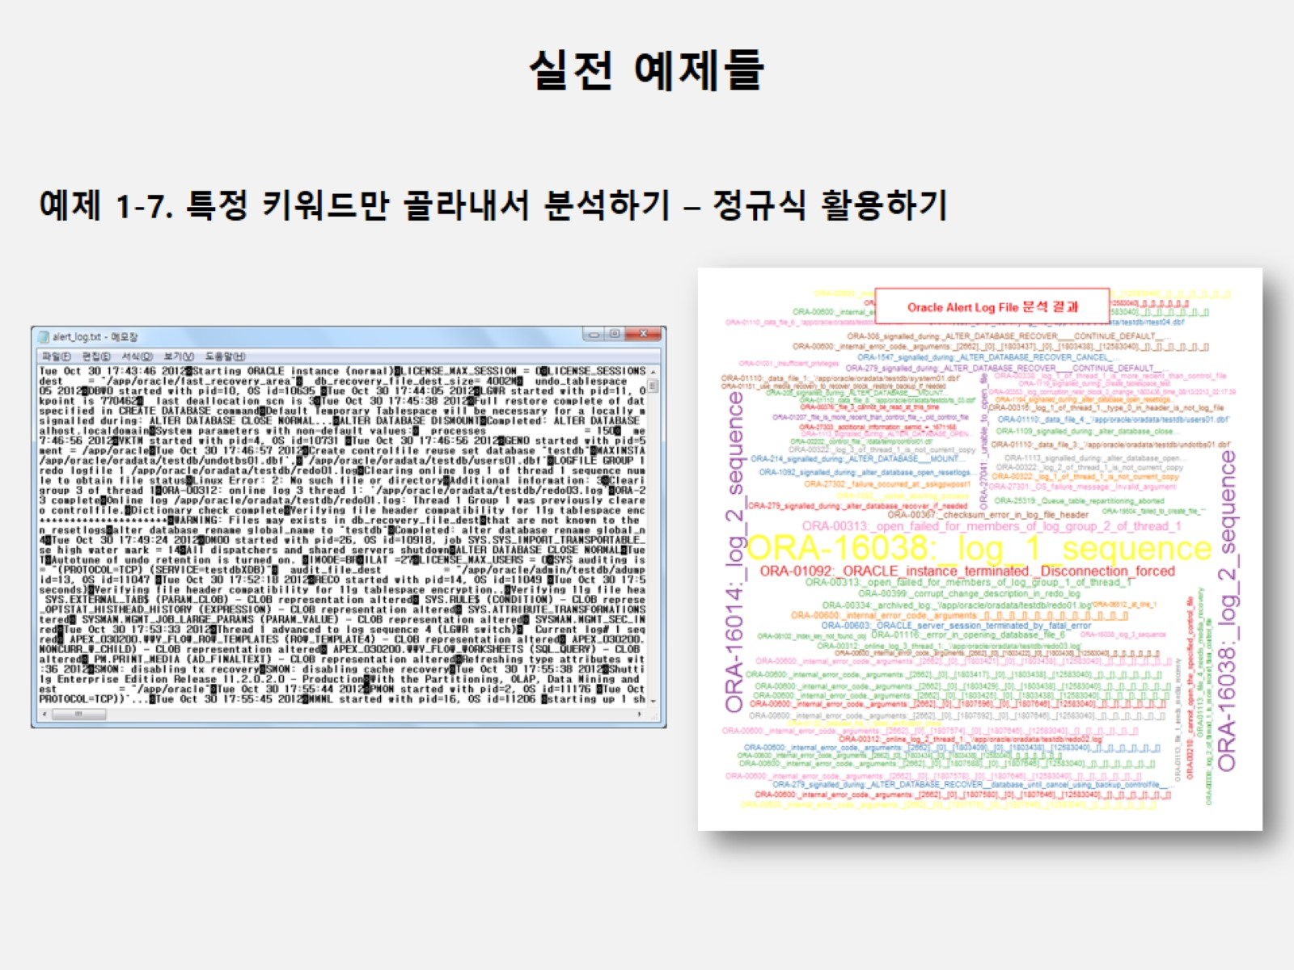

Slide 14
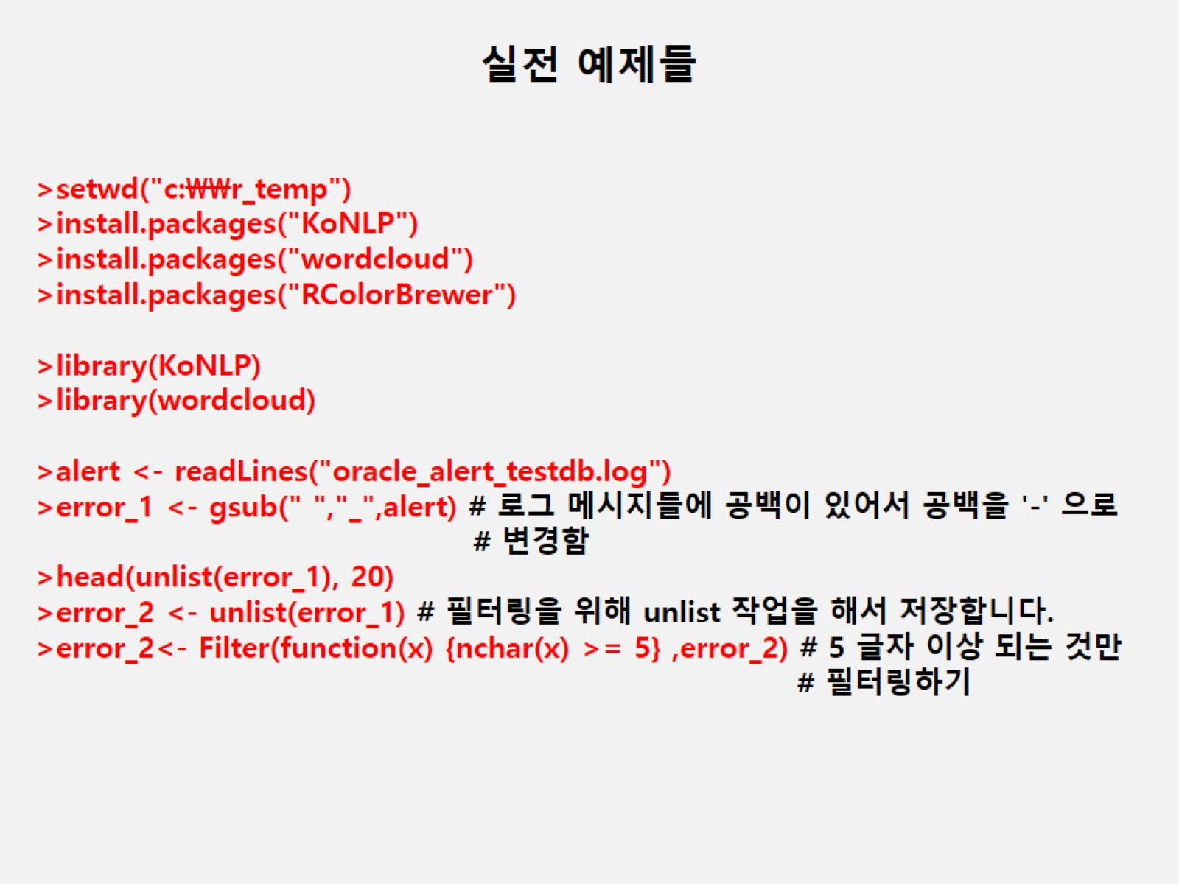
Notes:
setwd("c:\\easy_r")
install.packages("KoNLP")
install.packages("wordcloud")
install.packages("RColorBrewer")
library(KoNLP)
library(wordcloud)
alert<-readLines("oracle_alert_testdb.log")
error_1<-gsub(" ","_",alert)
head(unlist(error_1),20)

Slide 15
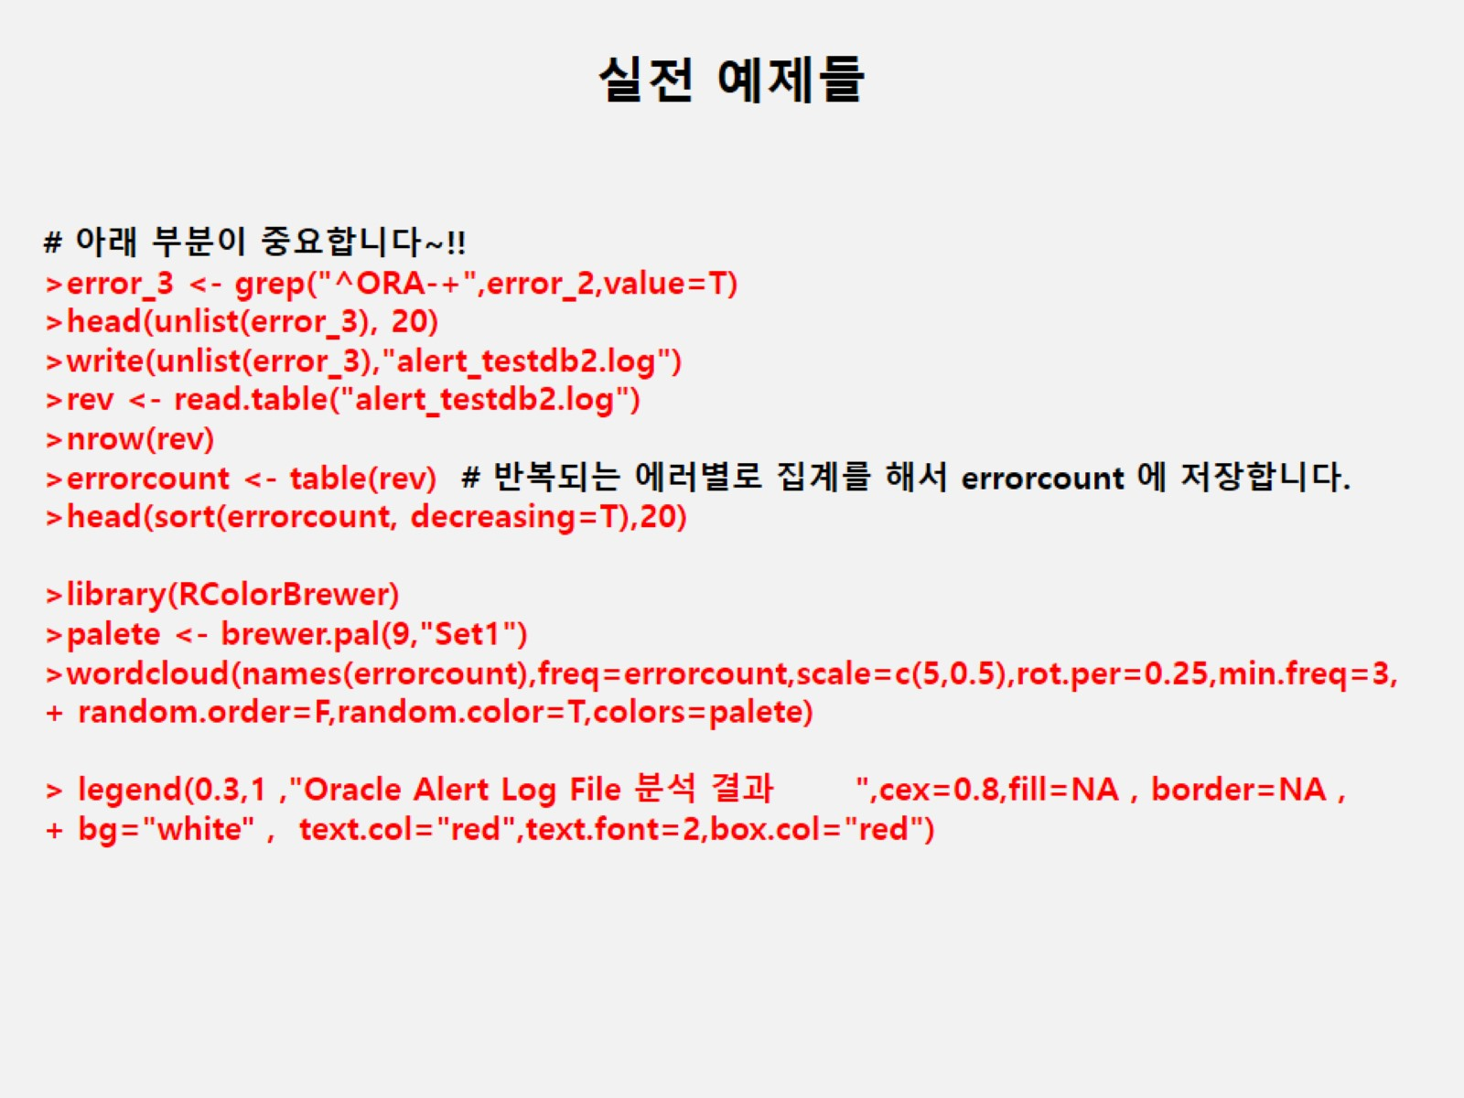
Notes:
setwd("c:\\easy_r")
install.packages("KoNLP")
install.packages("wordcloud")
install.packages("RColorBrewer")
library(KoNLP)
library(wordcloud)
alert<-readLines("oracle_alert_testdb.log")
error_1<-gsub(" ","_",alert)
head(unlist(error_1),20)
error_2<-unlist(error_1)
error_2<-Filter(function(x) {nchar(x)>=5},error_2)
error_3<-grep("^ORA-+",error_2,value=T)
head(unlist(error_3),20)
write(unlist(error_3),"alert_testdb2.log")
rev<-read.table("alert_testdb2.log")
nrow(rev)
errorcount<-table(rev)
head(sort(errorcount,decreasing = T),20)
library(RColorBrewer)
palete<-brewer.pal(9,"Set1")
wordcloud(names(errorcount),freq=errorcount,scale=c(5,0.5),rot.per = 0.25,min.freq=3,random.order = F,random.color=T,colors=palete)
legend(0.3,1, "Oracle Alert Log File 분석 결과",cex=0.8,fill=NA,border=NA,bg="white",text.col="red",text.font=2,box.col="red")

Slide 16
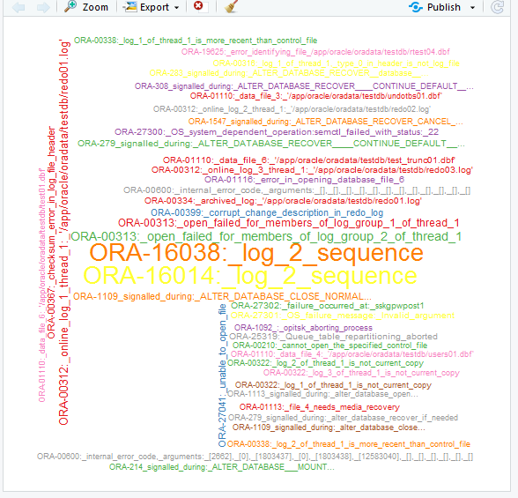
실전예제-정규식 활용
Notes:
setwd("c:\\easy_r")
install.packages("KoNLP")
install.packages("wordcloud")
install.packages("RColorBrewer")
library(KoNLP)
library(wordcloud)
alert<-readLines("oracle_alert_testdb.log")
error_1<-gsub(" ","_",alert)
head(unlist(error_1),20)
error_2<-unlist(error_1)
error_2<-Filter(function(x) {nchar(x)>=5},error_2)
error_3<-grep("^ORA-+",error_2,value=T)
head(unlist(error_3),20)
write(unlist(error_3),"alert_testdb2.log")
rev<-read.table("alert_testdb2.log")
nrow(rev)
errorcount<-table(rev)
head(sort(errorcount,decreasing = T),20)
library(RColorBrewer)
palete<-brewer.pal(9,"Set1")
wordcloud(names(errorcount),freq=errorcount,scale=c(5,0.5),rot.per = 0.25,min.freq=3,random.order = F,random.color=T,colors=palete)
legend(0.3,1, "Oracle Alert Log File 분석 결과",cex=0.8,fill=NA,border=NA,bg="white",text.col="red",text.font=2,box.col="red")

Slide 17
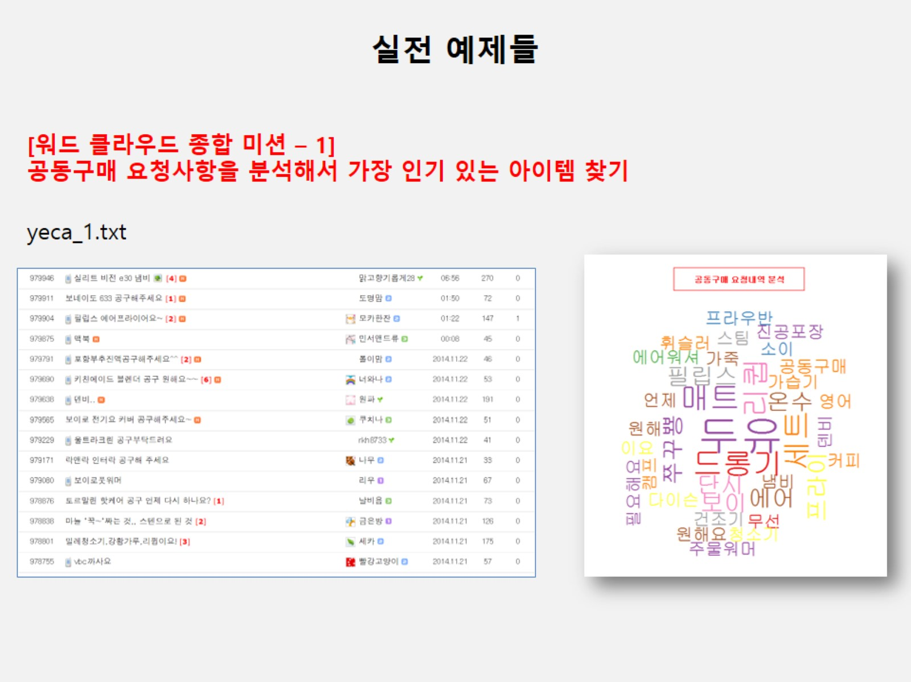
Notes:
setwd("c:\\easy_r")
install.packages("KoNLP")
install.packages("wordcloud")
install.packages("stringr")
library(KoNLP)
library(wordcloud)
library(stringr)
useSejongDic()
mergeUserDic(data.frame(readLines("공동구매 아이템 찾기
.txt"),"ncn"))
txt<-readLines("yeca_1.txt")
place<-sapply(txt,extractNoun,USE.NAMES = F)
place
head(unlist(place),30)
cdata<-unlist(place)
place<-str_replace_all(cdata,"[^[:alpha:]]","")
place<-gsub(" ","",place)
txt<-readLines("yecagsub.txt")
txt
cnt_txt<-length(txt)
cnt_txt
i<-1
for(i in 1:cnt_txt){
place<-gsub((txt[i]),"",place)
}
place
place<-Filter(function(x){nchar(x)>=2},place)
write(unlist(place),"yeca_1_2.txt")
rev<-read.table("yeca_1_2.txt")
nrow(rev)
wordcount<-table(rev)
head(sort(wordcount,decreasing = T),30)
library(RColorBrewer)
palete<-brewer.pal(9,"Set1")
wordcloud(names(wordcount),freq=wordcount,scale=c(5,0.5),rot.per = 0.25,min.freq=2,random.order = F,random.color=T,colors=palete)
legend(0.3,1, "공동구매 요청내역 분석",cex=0.8,fill=NA,border=NA,bg="white",text.col="red",text.font=2,box.col="red")

Slide 18
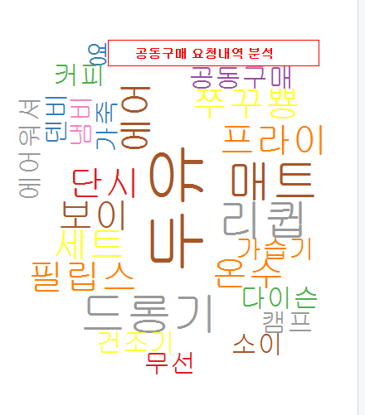
공동구매 요청내역 분석
Yeca_1.txt
Yecagsub-제외
Notes:
setwd("c:\\easy_r")
install.packages("KoNLP")
install.packages("wordcloud")
install.packages("stringr")
library(KoNLP)
library(wordcloud)
library(stringr)
useSejongDic()
mergeUserDic(data.frame(readLines("공동구매 아이템 찾기
.txt"),"ncn"))
txt<-readLines("yeca_1.txt")
place<-sapply(txt,extractNoun,USE.NAMES = F)
place
head(unlist(place),30)
cdata<-unlist(place)
place<-str_replace_all(cdata,"[^[:alpha:]]","")
place<-gsub(" ","",place)
txt<-readLines("yecagsub.txt")
txt
cnt_txt<-length(txt)
cnt_txt
i<-1
for(i in 1:cnt_txt){
place<-gsub((txt[i]),"",place)
}
place
place<-Filter(function(x){nchar(x)>=2},place)
write(unlist(place),"yeca_1_2.txt")
rev<-read.table("yeca_1_2.txt")
nrow(rev)
wordcount<-table(rev)
head(sort(wordcount,decreasing = T),30)
library(RColorBrewer)
palete<-brewer.pal(9,"Set1")
wordcloud(names(wordcount),freq=wordcount,scale=c(5,0.5),rot.per = 0.25,min.freq=2,random.order = F,random.color=T,colors=palete)
legend(0.3,1, "공동구매 요청내역 분석",cex=0.8,fill=NA,border=NA,bg="white",text.col="red",text.font=2,box.col="red")

Slide 19
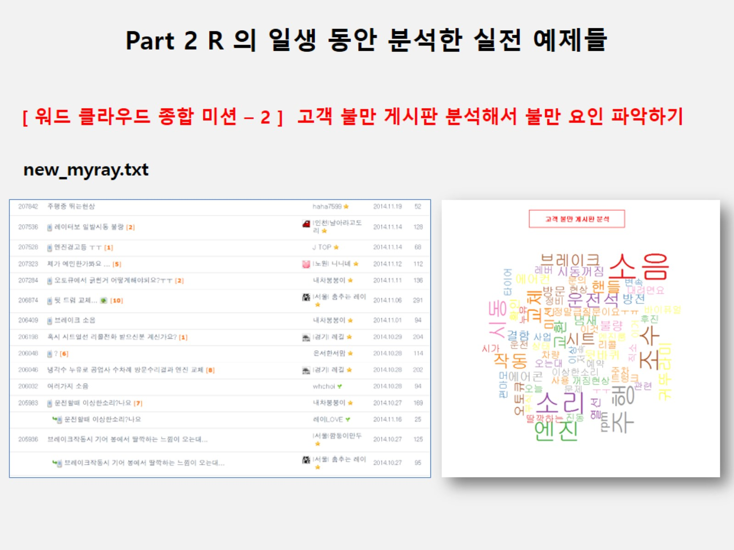

Slide 20
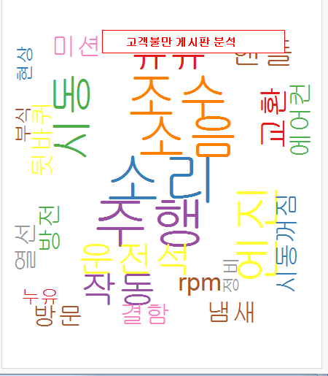
고객불만 게시판 분석
Notes:
setwd("c:\\easy_r")
install.packages("KoNLP")
install.packages("wordcloud")
install.packages("stringr")
library(KoNLP)
library(wordcloud)
library(stringr)
useSejongDic()
mergeUserDic(data.frame(readLines("게시판.txt"),"ncn"))
txt<-readLines("new_myray.txt")
place<-sapply(txt,extractNoun,USE.NAMES = F)
place
head(unlist(place),30)
cdata<-unlist(place)
place<-str_replace_all(cdata,"[^[:alpha:]]","")
place<-gsub(" ","",place)
txt<-readLines("도서검색gsub.txt")
txt
cnt_txt<-length(txt)
cnt_txt
i<-1
for(i in 1:cnt_txt){
place<-gsub((txt[i]),"",place)
}
place
place<-Filter(function(x){nchar(x)>=2},place)
write(unlist(place),"new_myray_2.txt")
rev<-read.table("new_myray_2.txt")
nrow(rev)
wordcount<-table(rev)
head(sort(wordcount,decreasing = T),30)
library(RColorBrewer)
palete<-brewer.pal(9,"Set1")
wordcloud(names(wordcount),freq=wordcount,scale=c(5,0.5),rot.per = 0.25,min.freq=2,random.order = F,random.color=T,colors=palete)
legend(0.3,1, "고객불만 게시판 분석",cex=0.8,fill=NA,border=NA,bg="white",text.col="red",text.font=2,box.col="red")

Slide 21
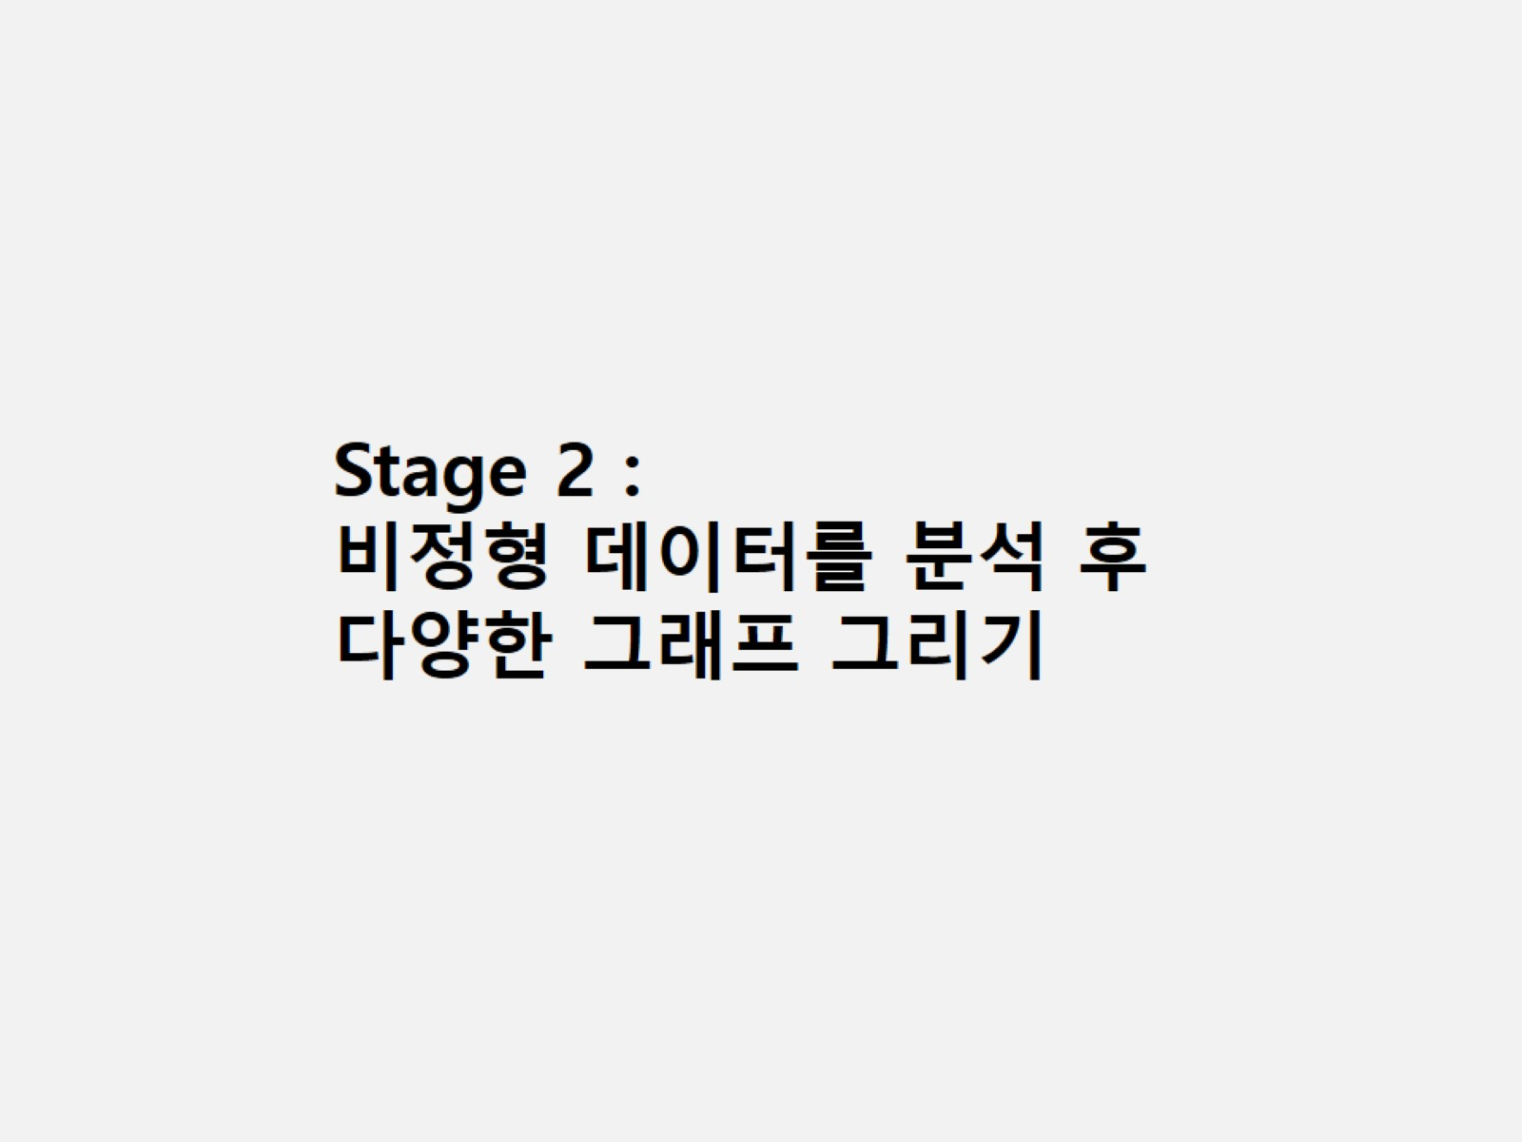

Slide 22
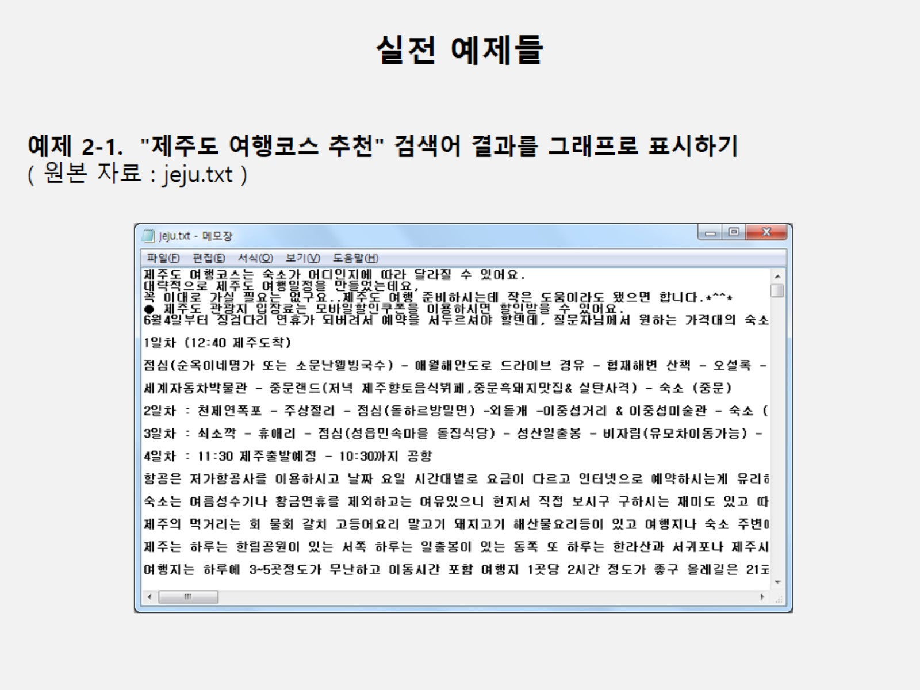

Slide 23
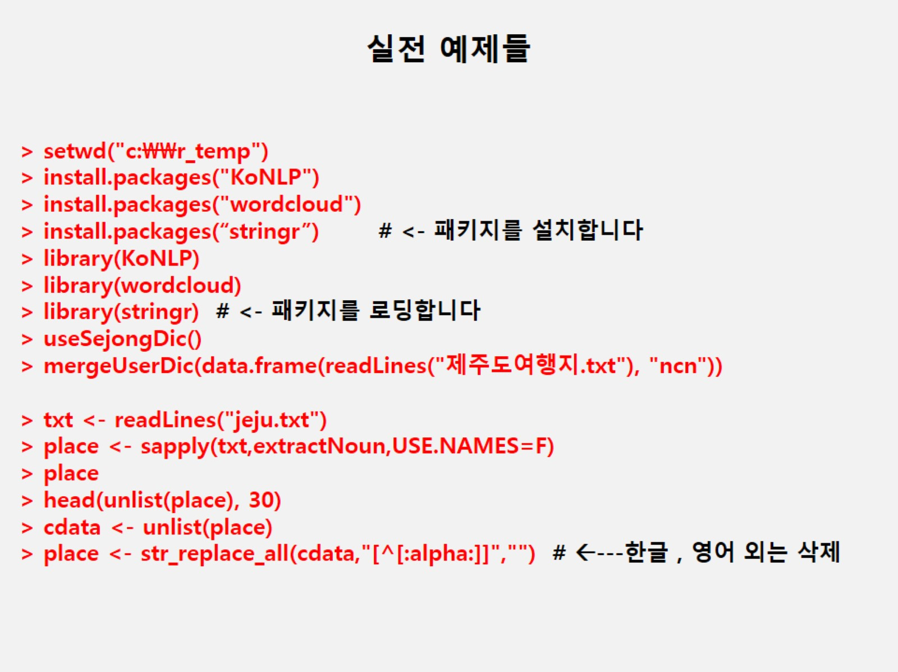

Slide 24
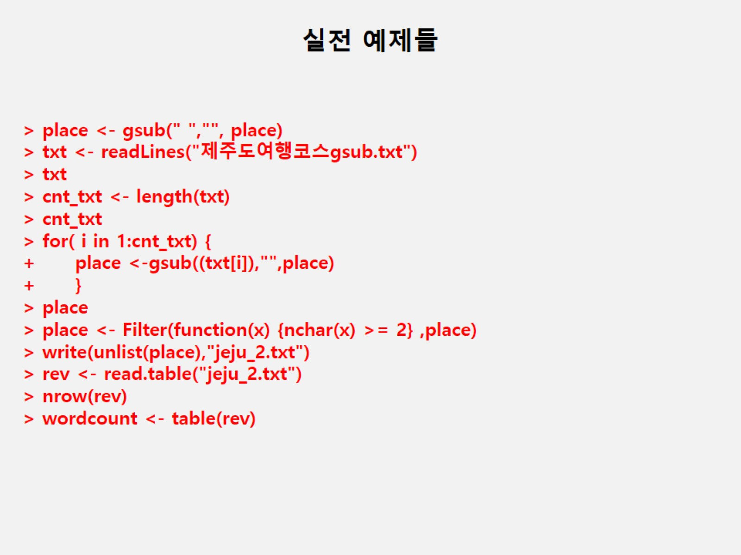

Slide 25
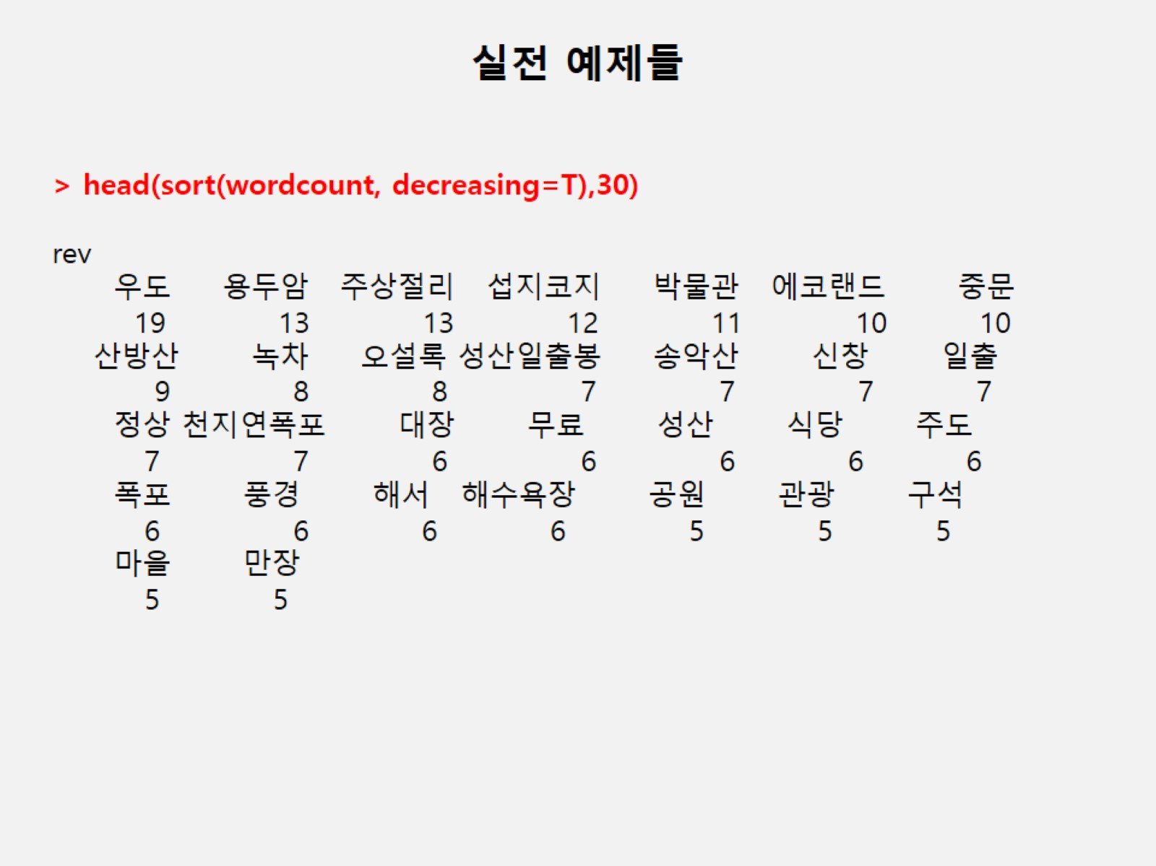

Slide 26
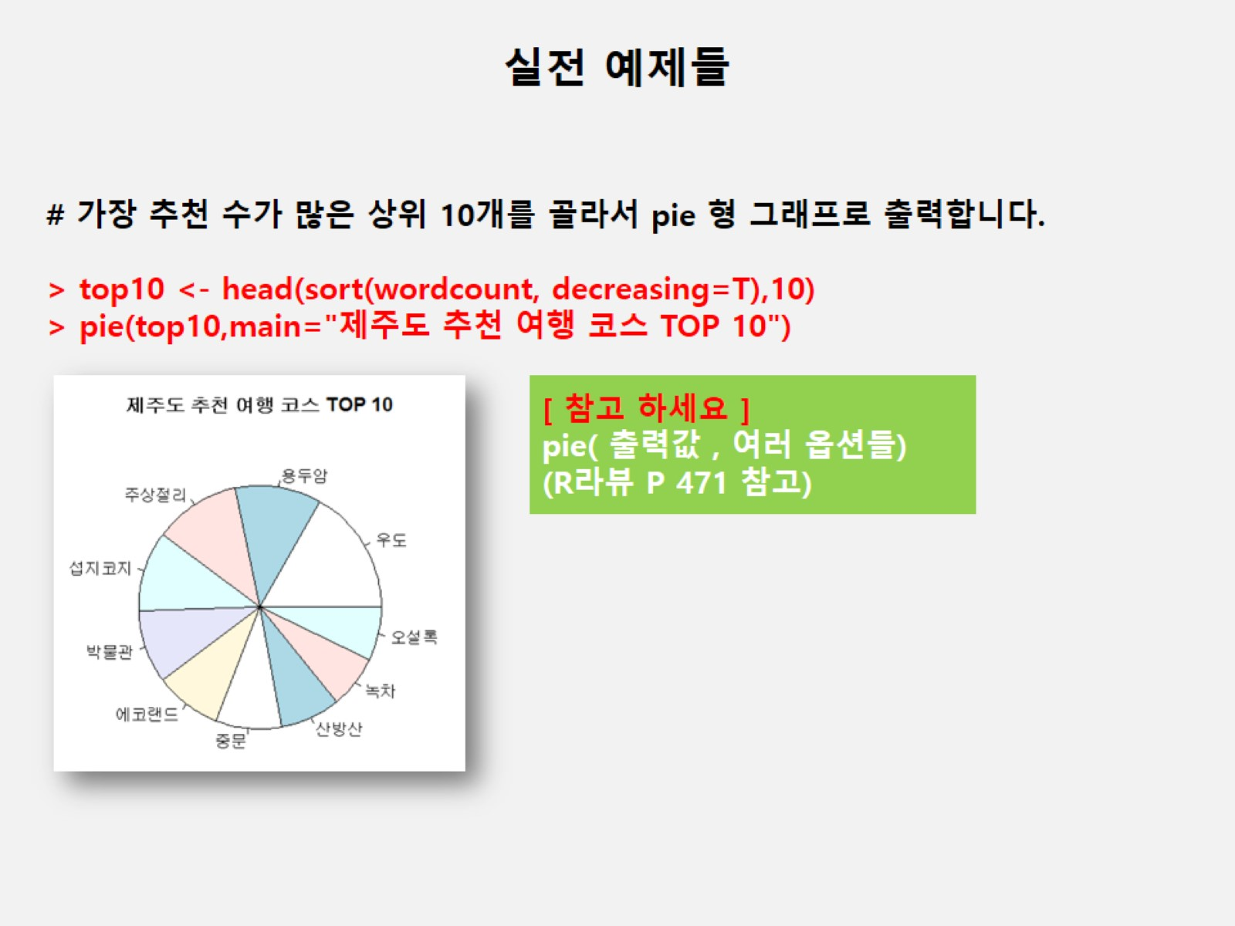

Slide 27
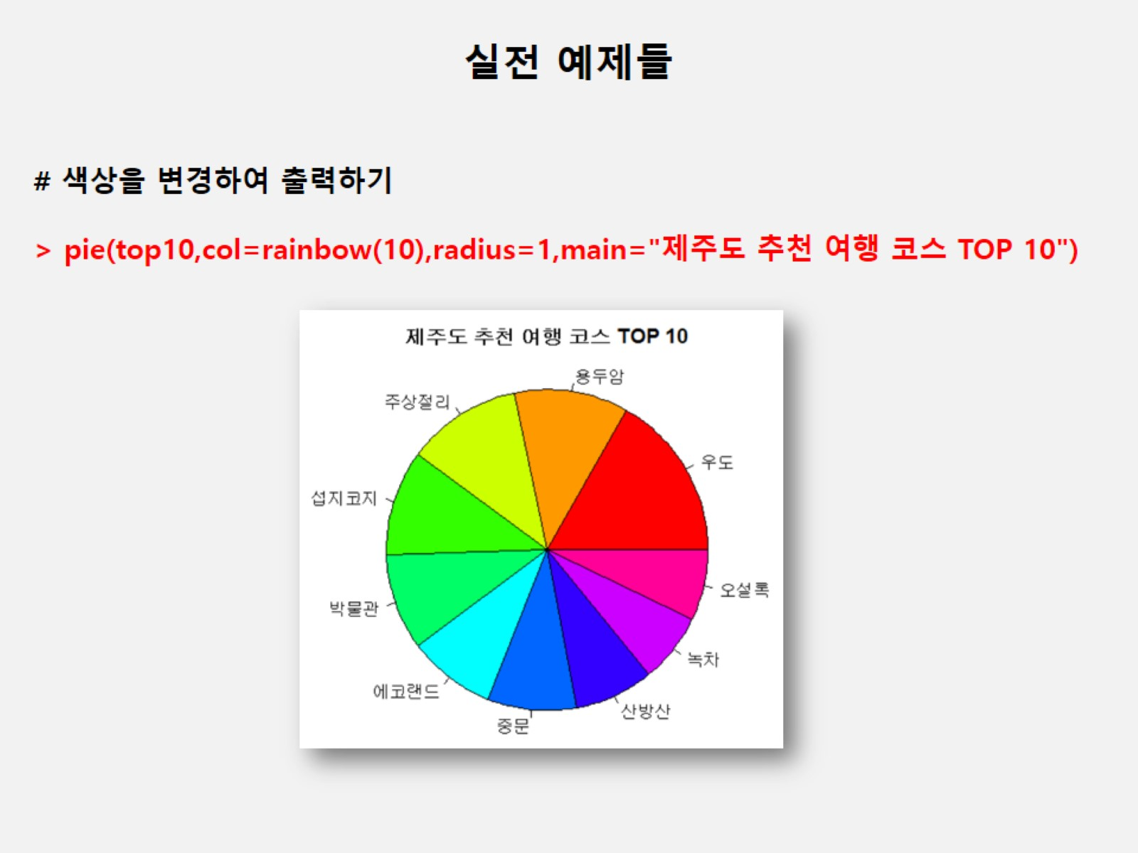

Slide 28
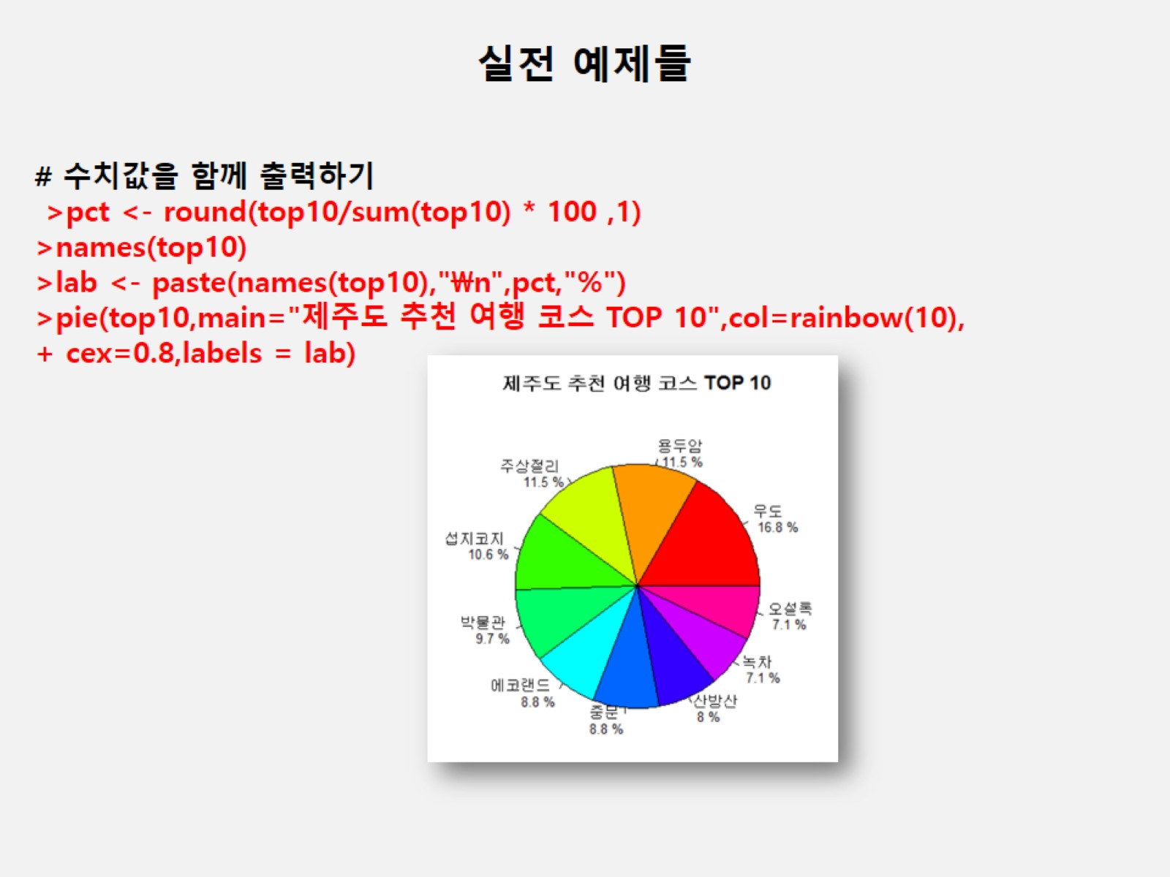

Slide 29
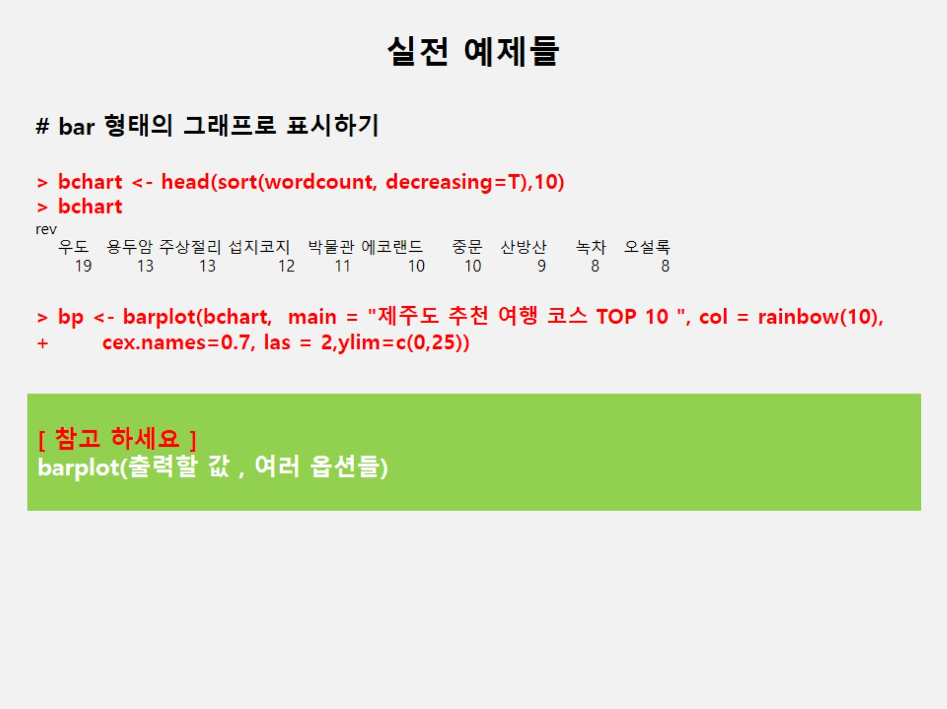

Slide 30
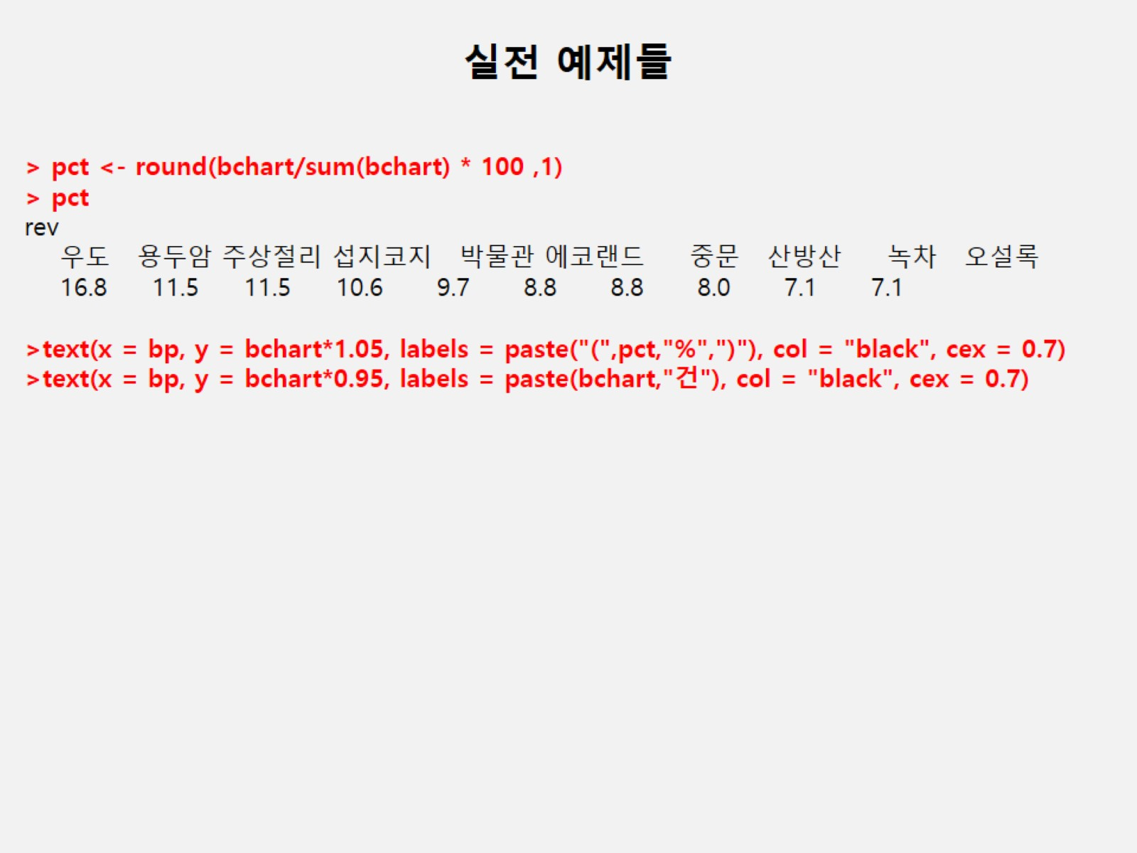

Slide 31
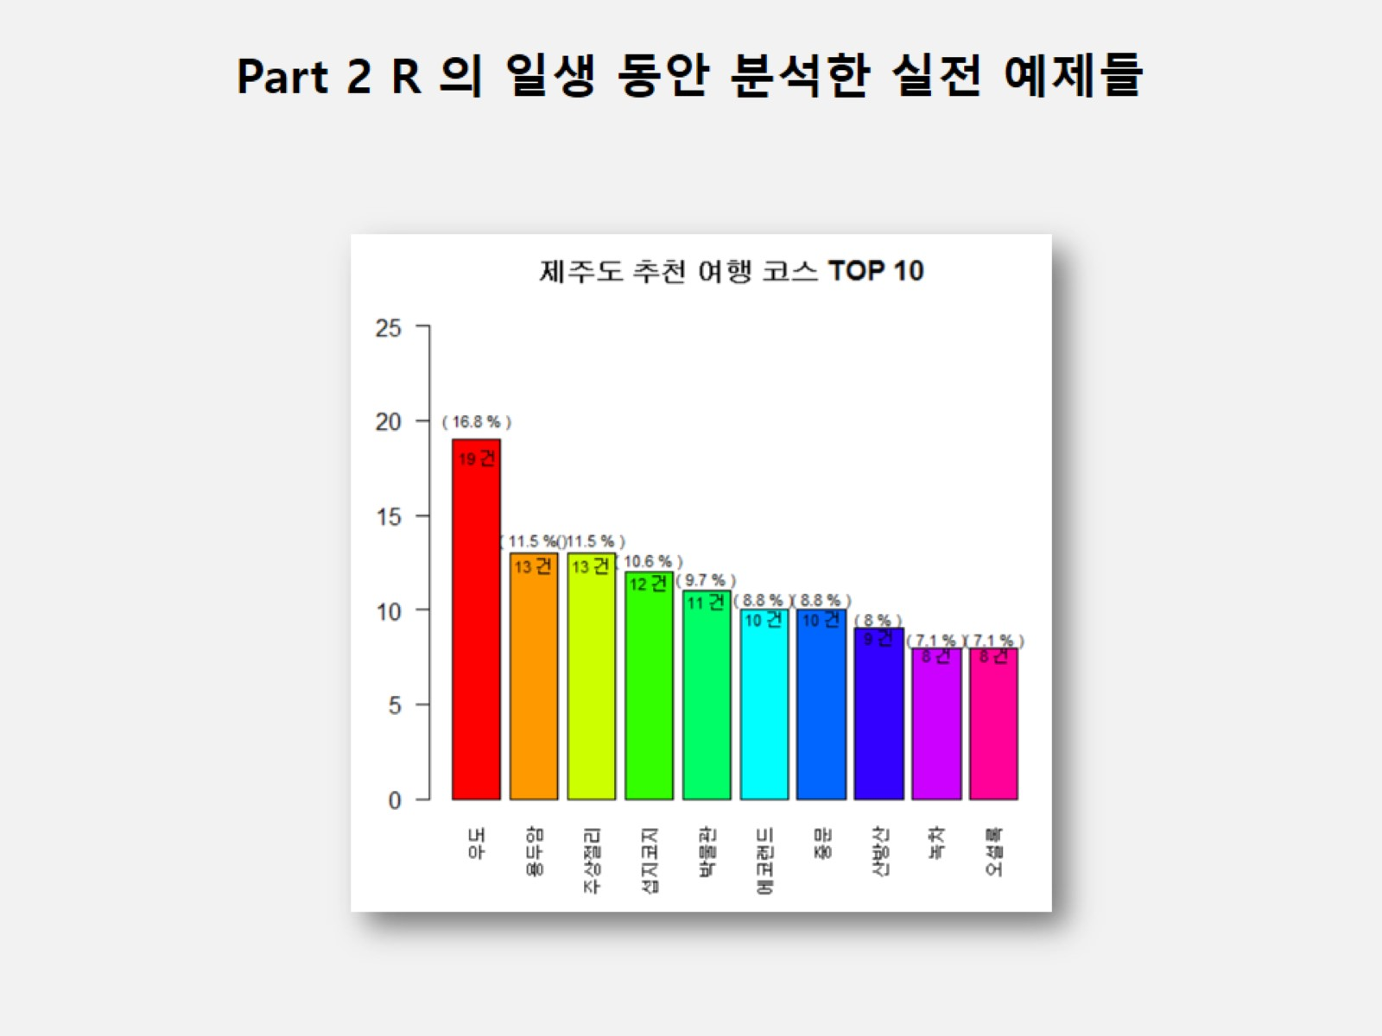

Slide 32
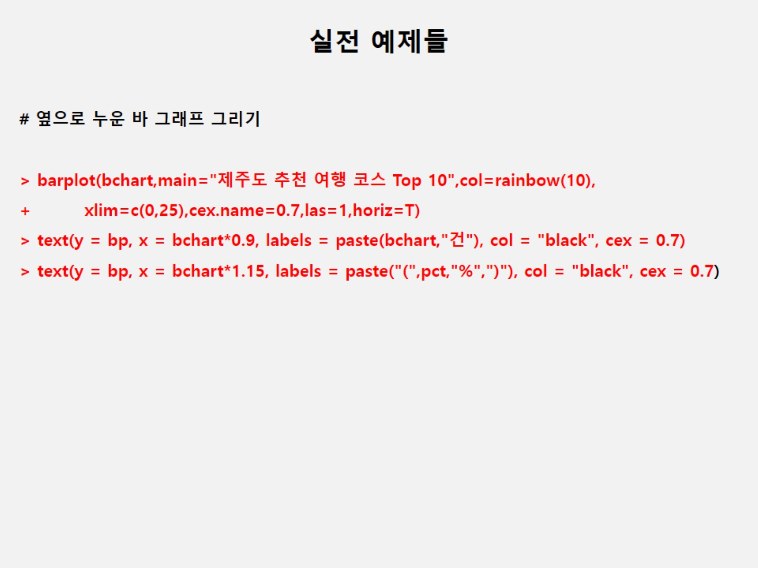

Slide 33
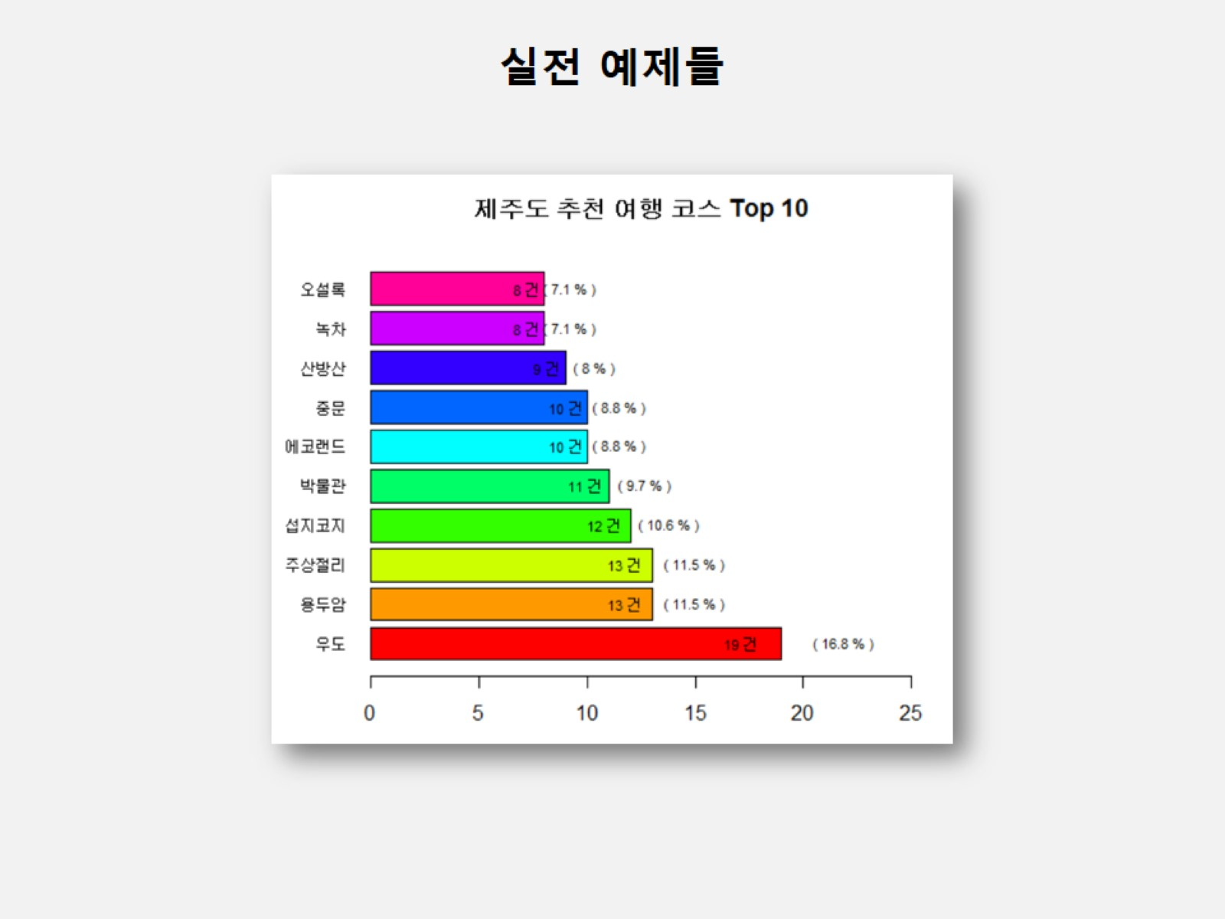

Slide 34
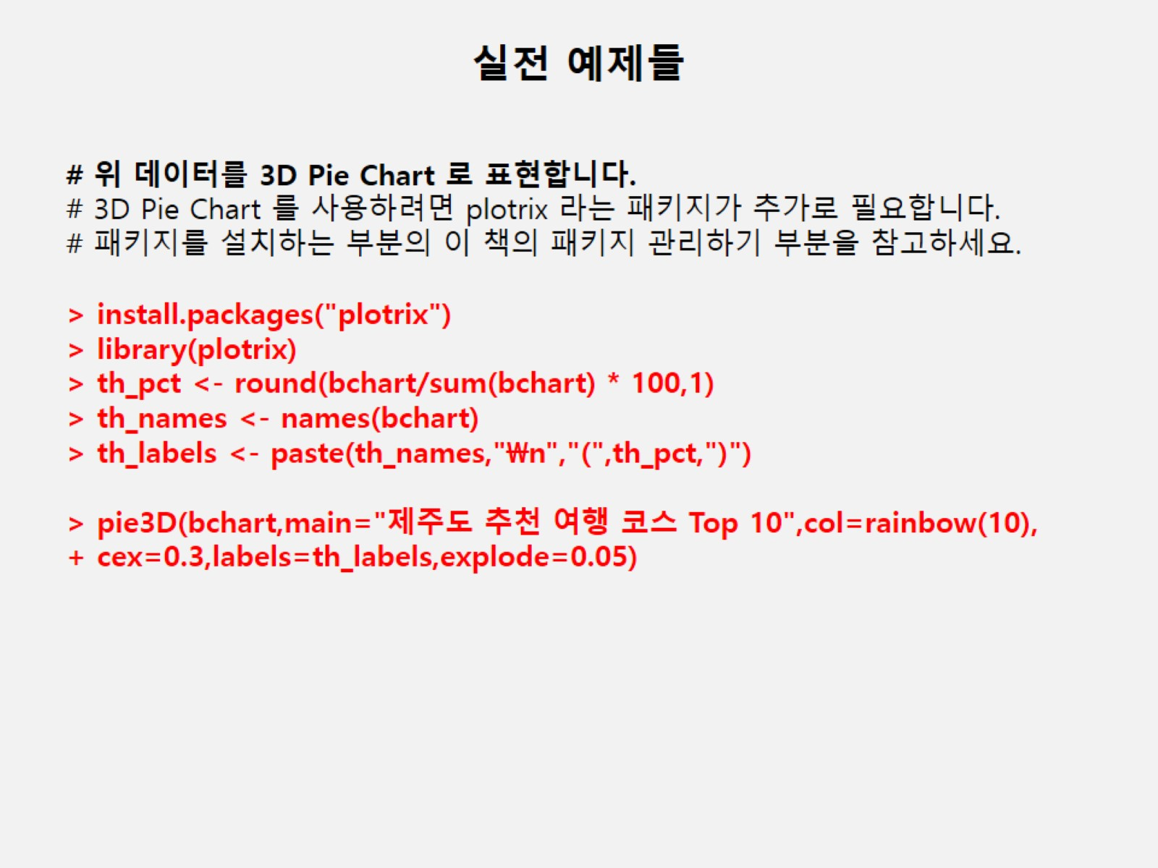

Slide 35
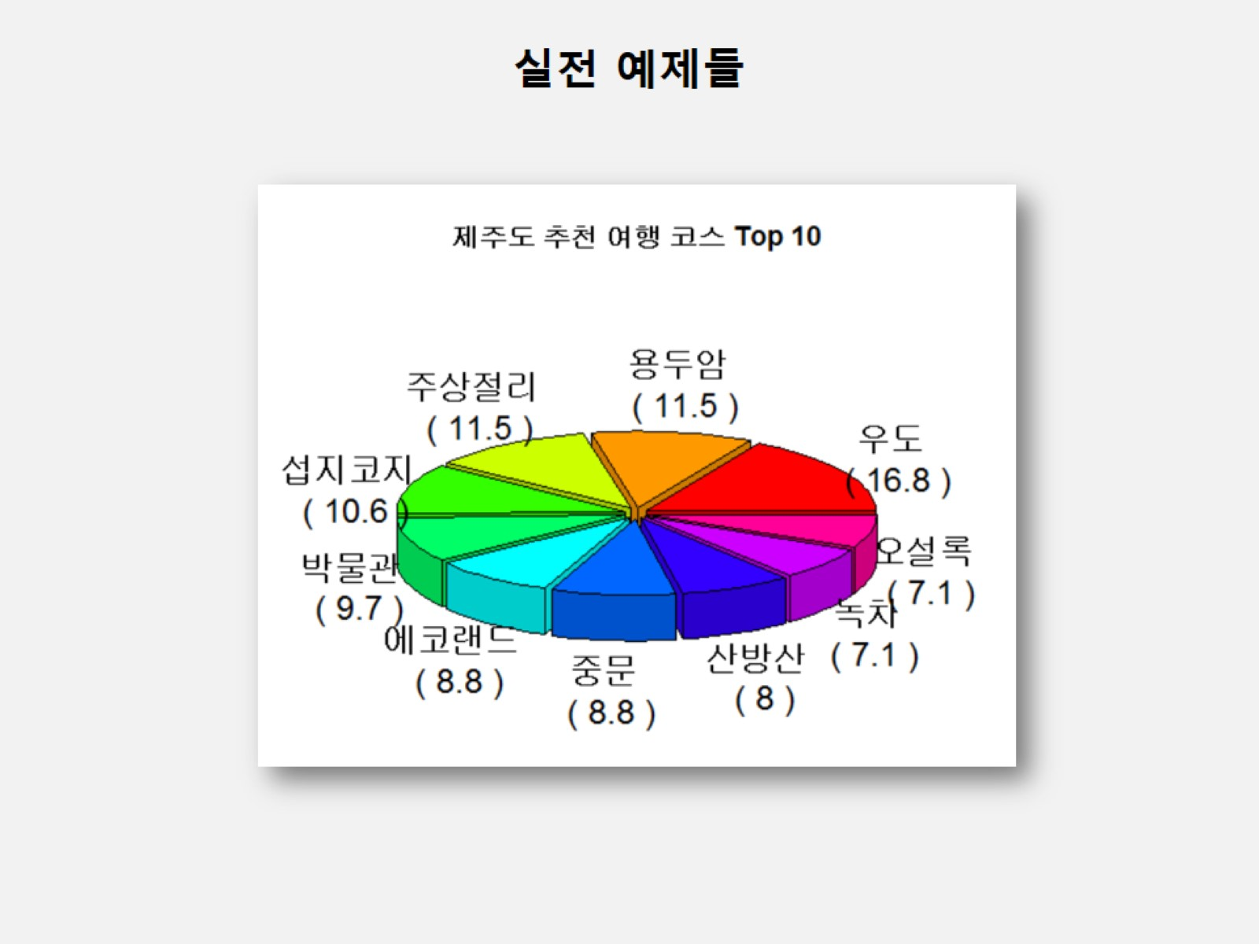

Slide 36
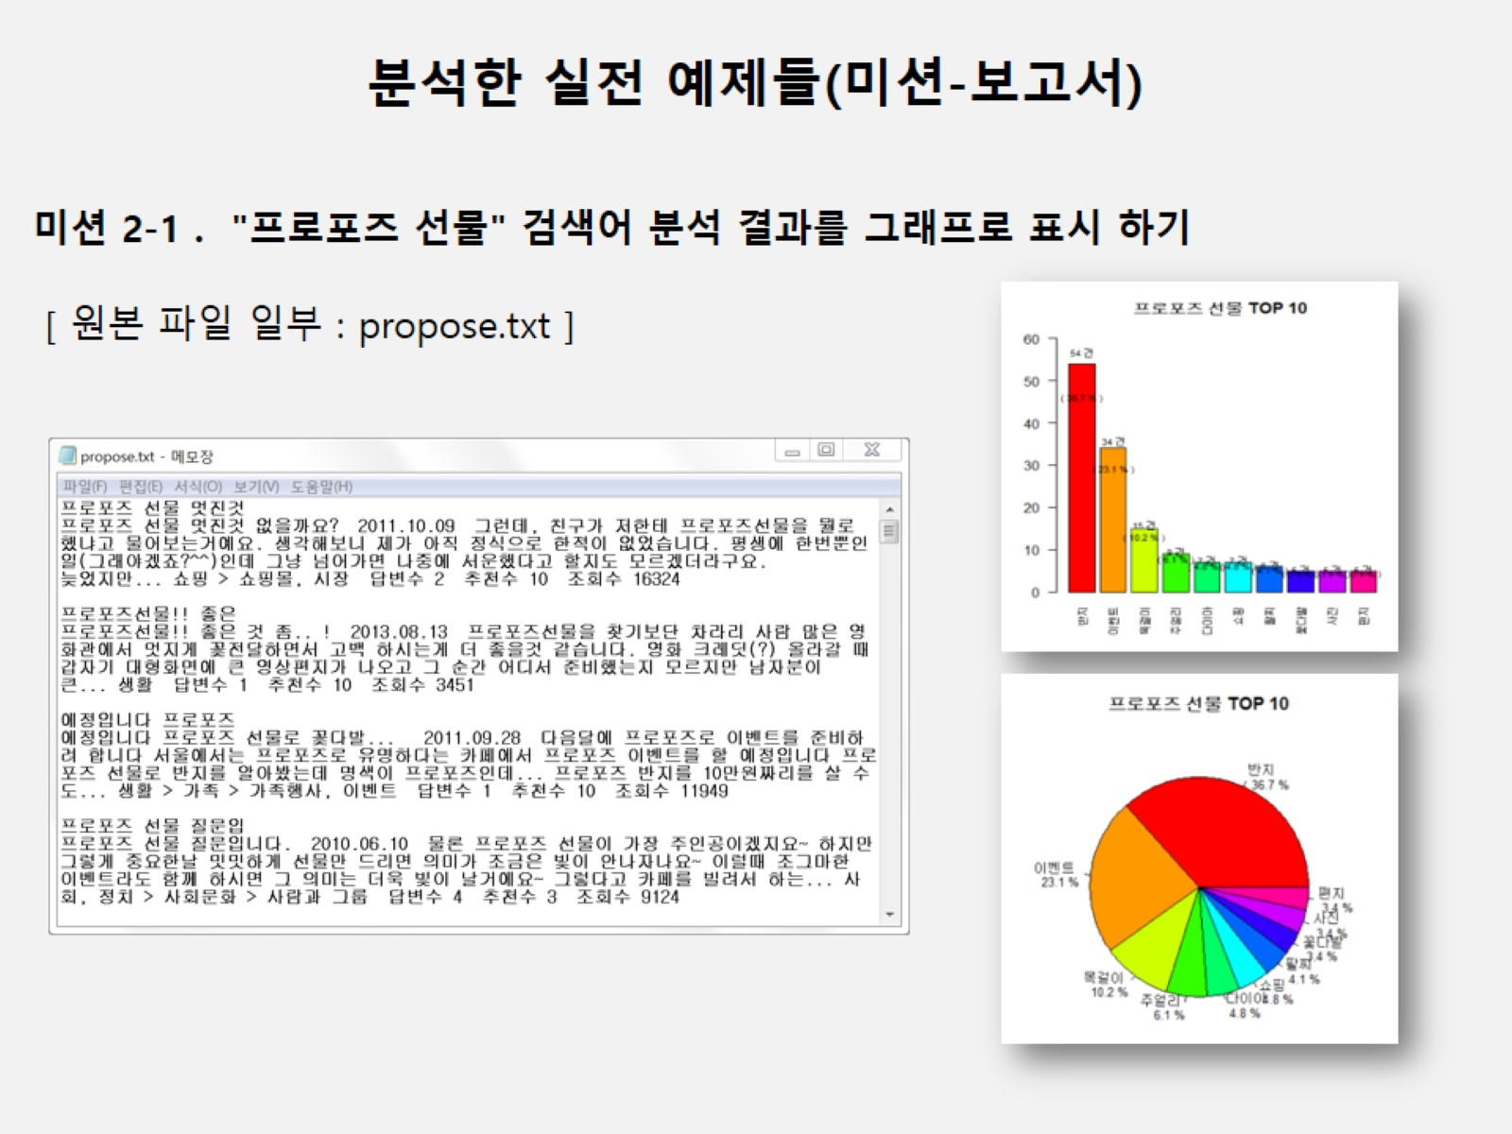

Slide 37
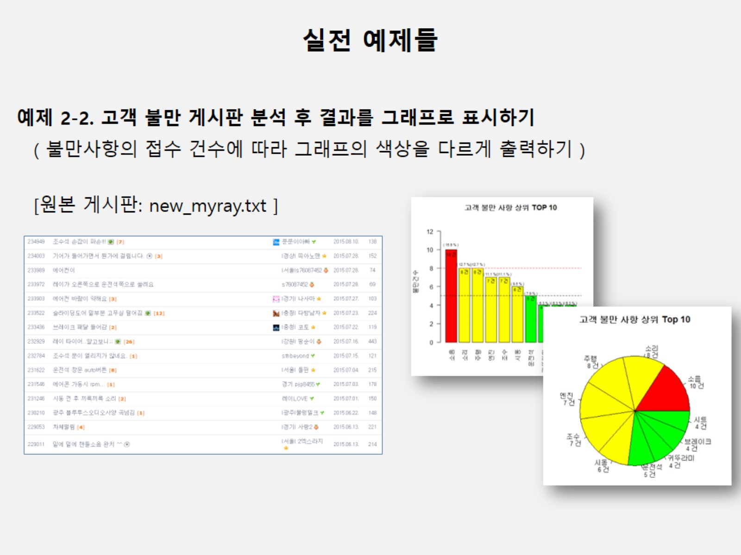

Slide 38
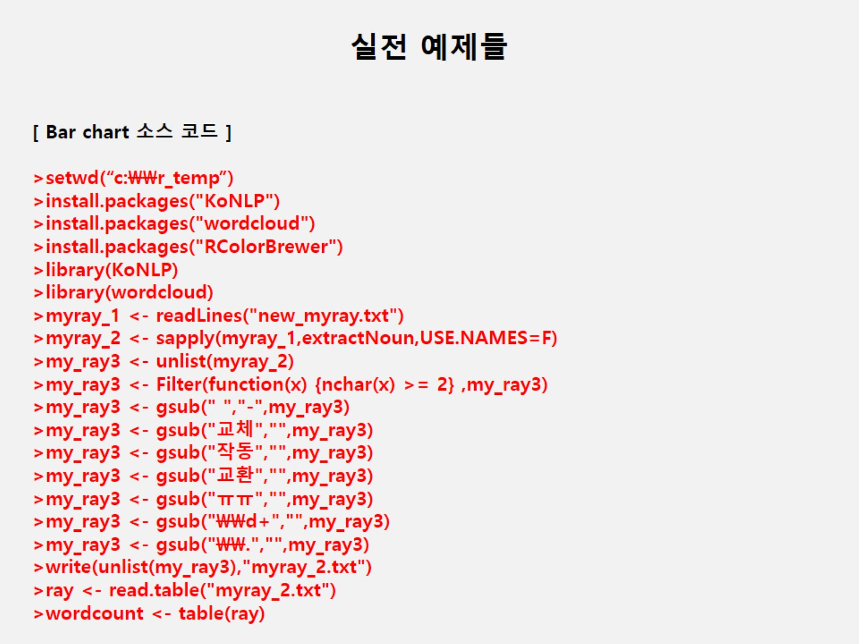

Slide 39
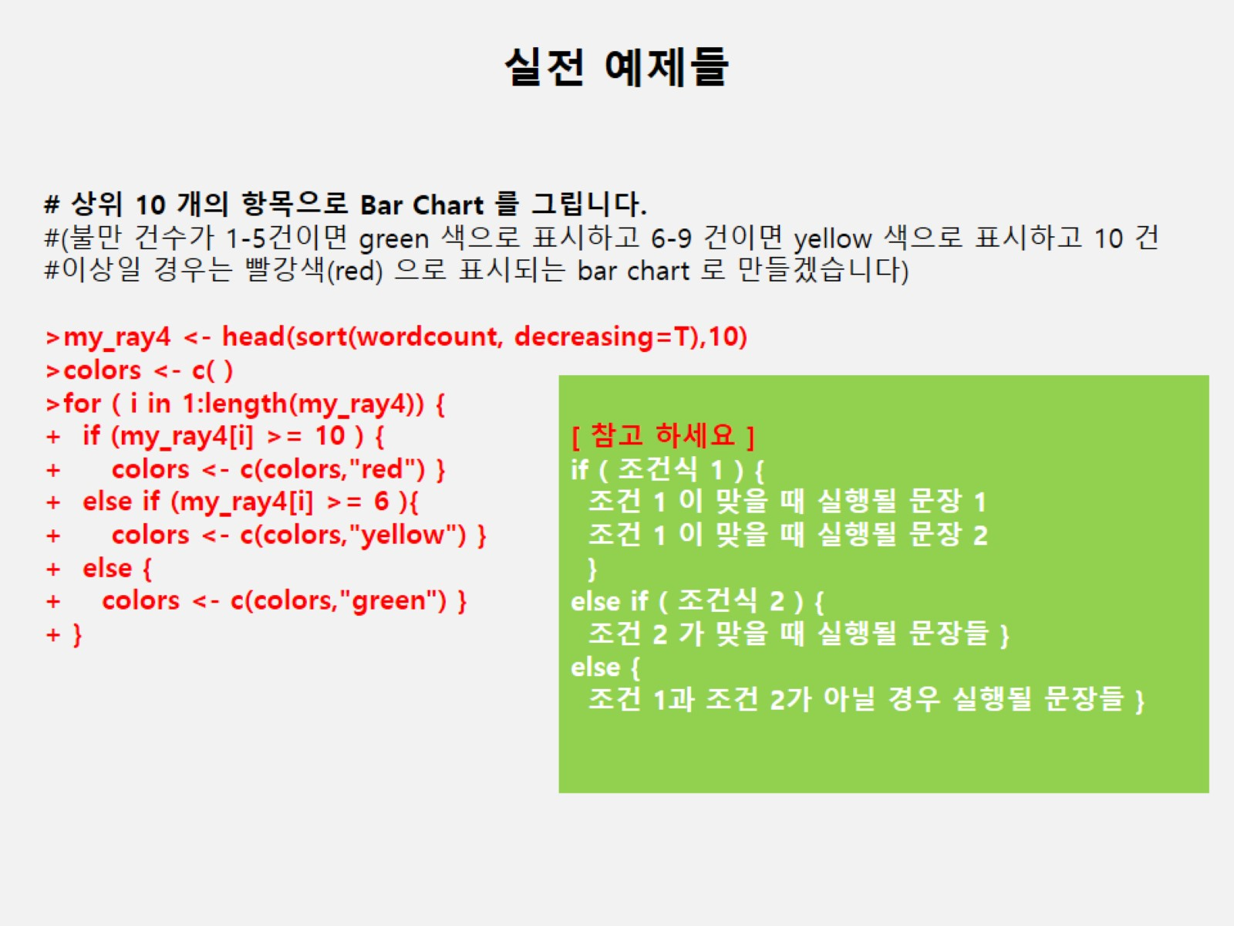

Slide 40
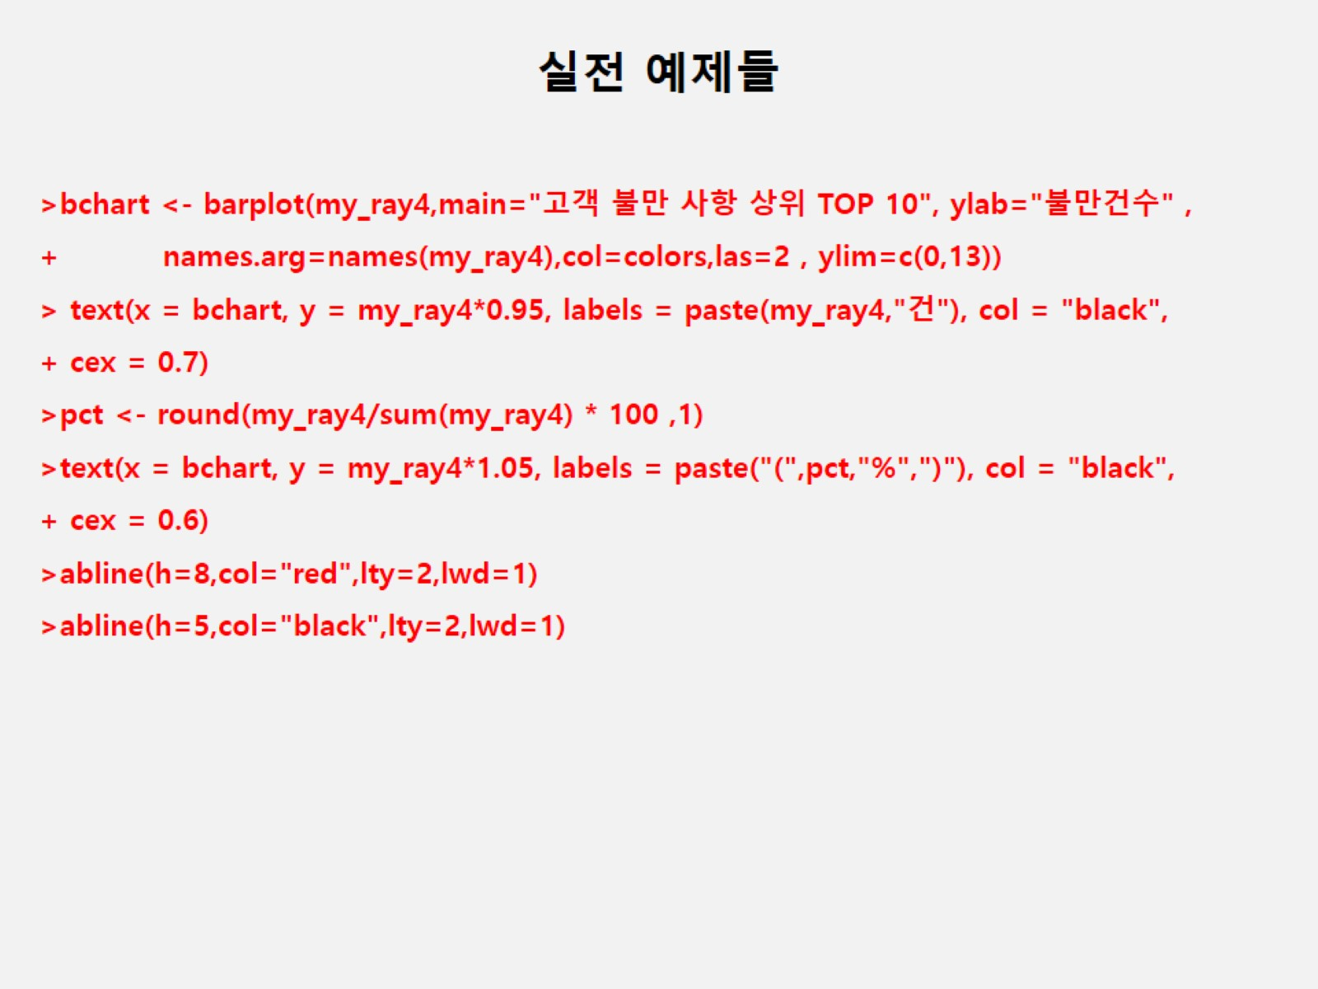

Slide 41
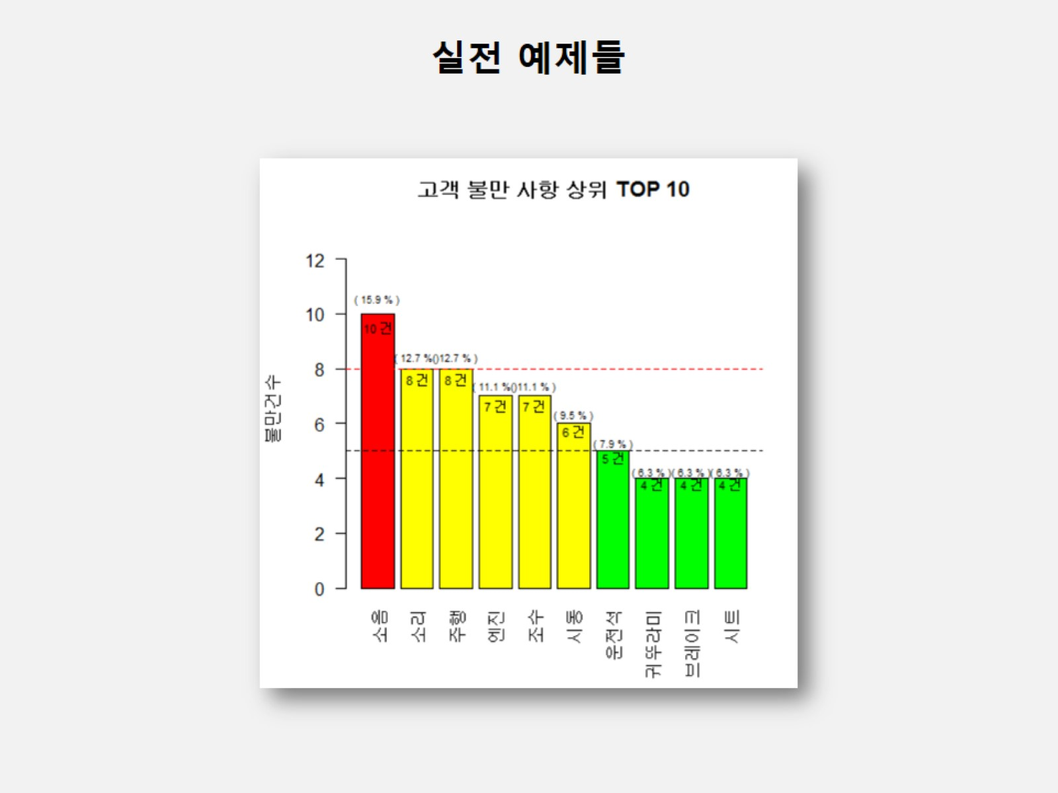

Slide 42
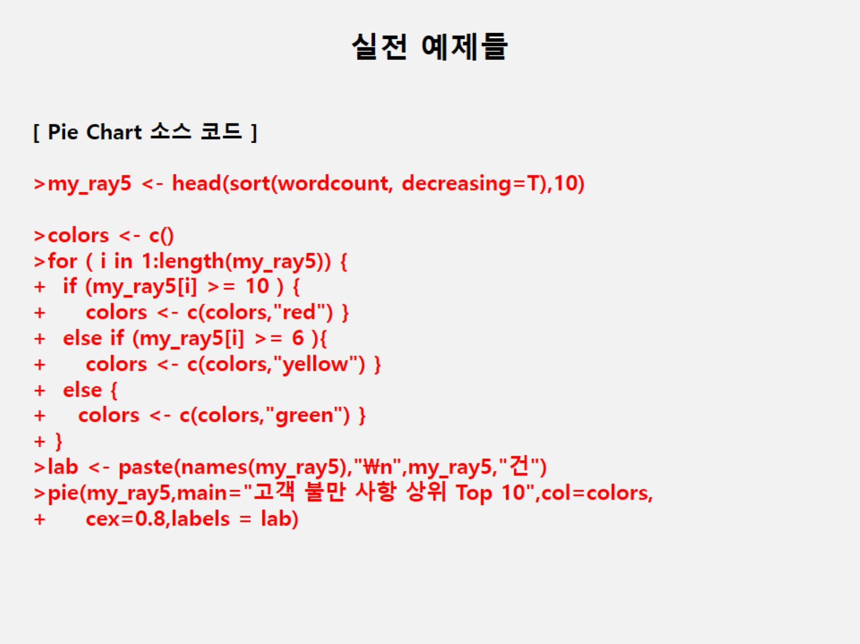

Slide 43
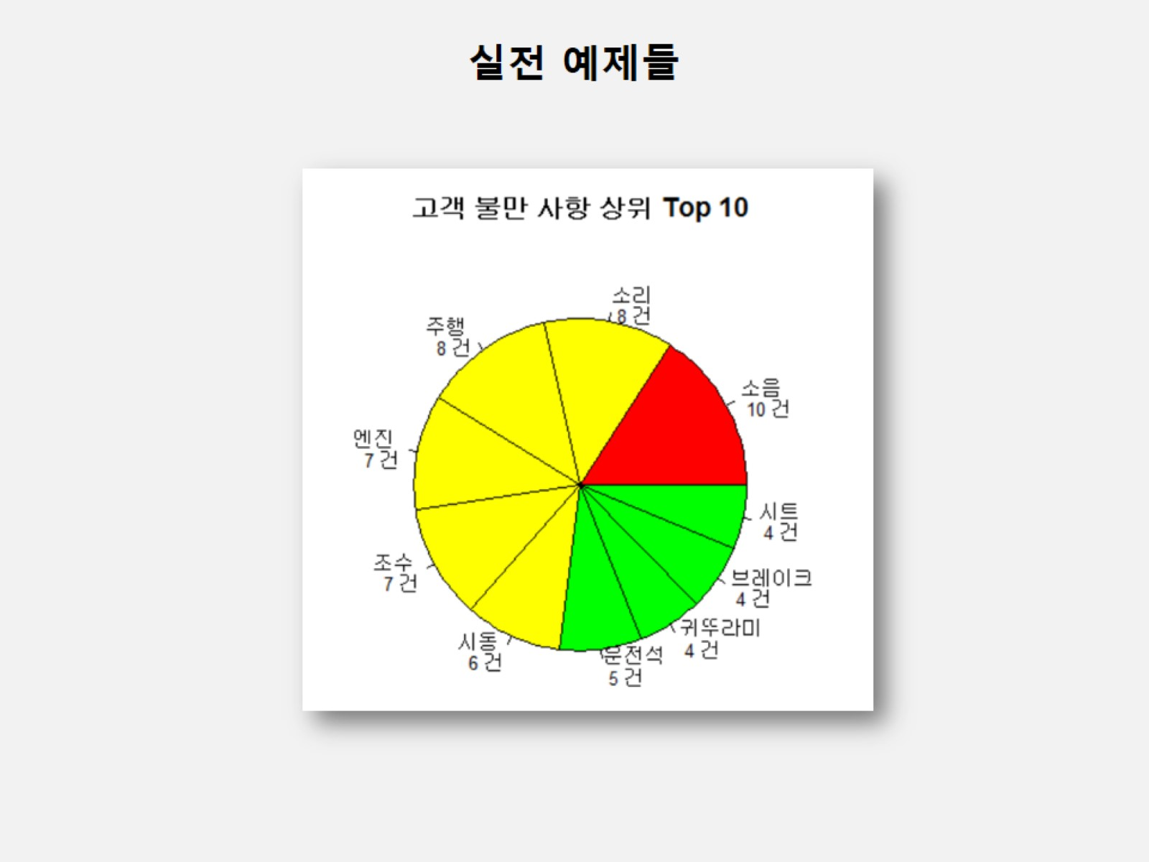

Slide 44
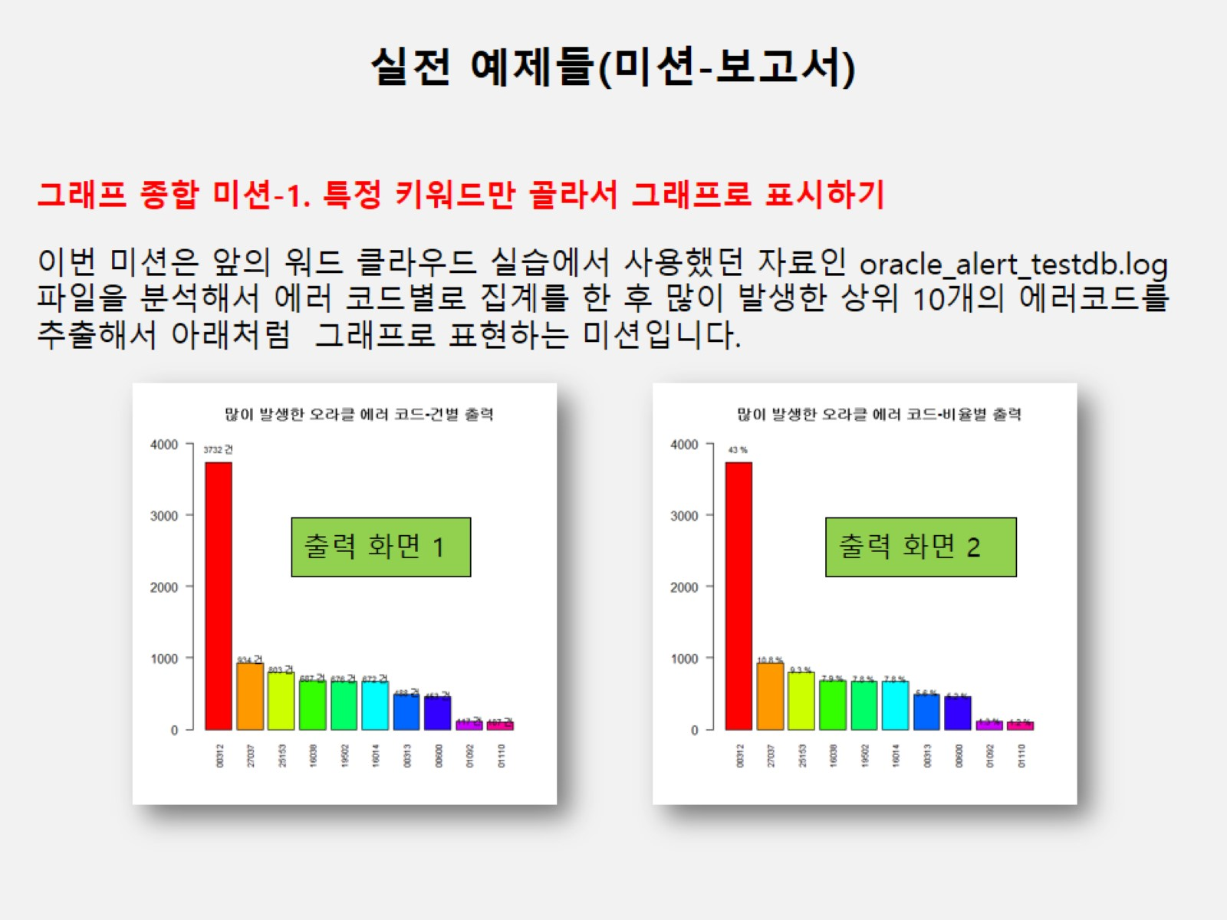

Slide 45
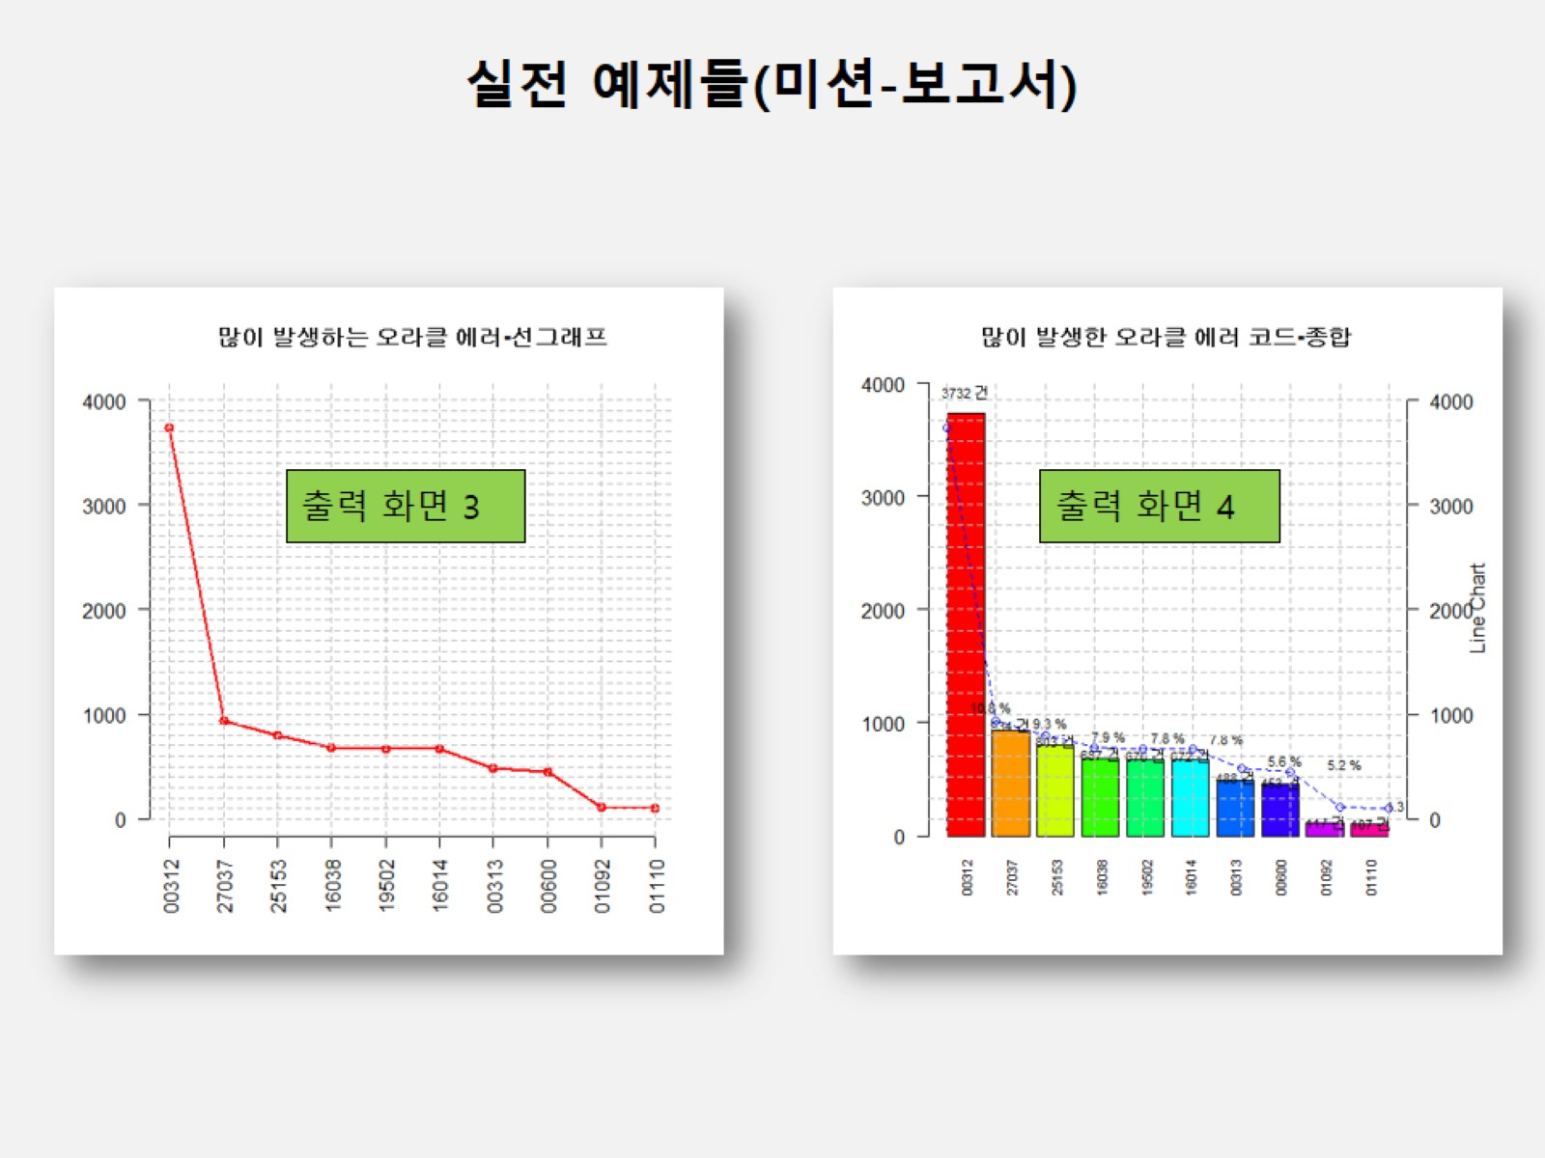

Slide 46
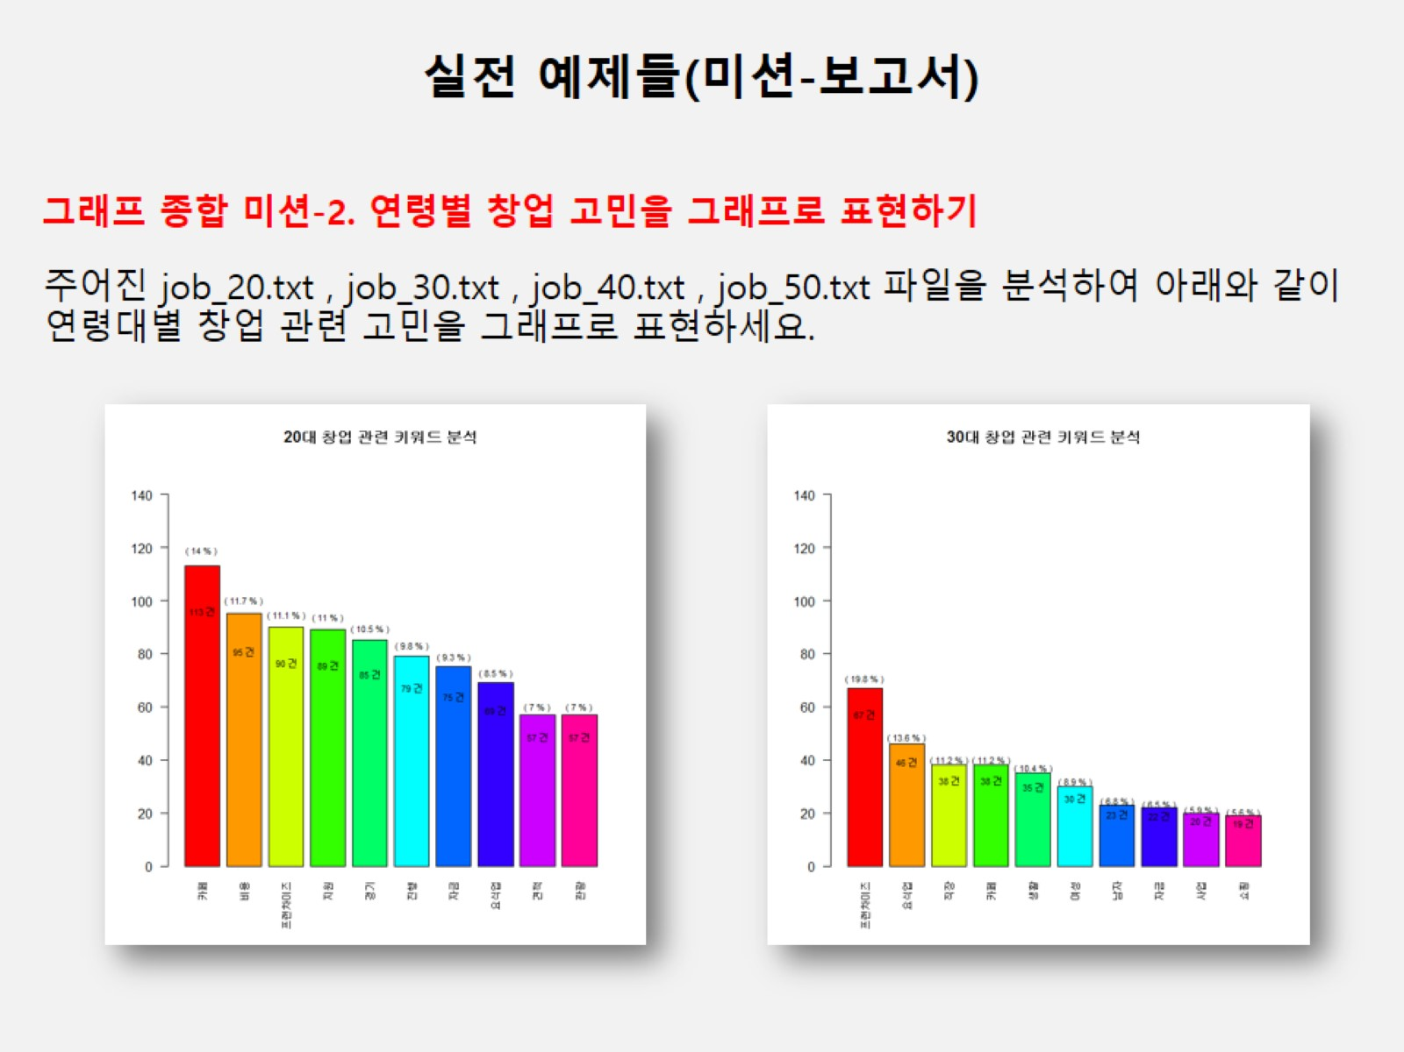

Slide 47
